Slide 1

Caring for You
Refresh 2022

Slide 2

Background
We know that supportive and open workplaces benefit
both staff and service users.
People perform better when they are confident and motivated and good health, safety and wellbeing underpins this.
Investment in staff is an investment in care for women
and their families.
A

Slide 3
Background
March 2016 We surveyed RCM members about their health, safety and wellbeing at work.
June 2016 RCM launched the C4Y campaign - Aim of improving the health, safety and wellbeing of our members in their workplaces across the UK.
Ethos of our campaign was simple; healthy and well rested midwives
and maternity support workers we know can and will provide safe high
quality care for women and their families.
A

Slide 4
Background
December 2017 & November 2020 - Follow up all member H&W surveys
2021 – Members work experience /satisfaction survey
April 2022 – Caring for You Refresh launched
A

Slide 5
RCM Follow Up National Survey
2016 Survey Results | 2017 Survey Results
21% take their breaks | 26.6% Take their breaks
44% skipped their breaks | 37.7% skipped their breaks
62% said they feel dehydrated at work | 56.6% feel dehydrated at work
62% said they delayed using the toilet | 54.2% said they delayed using the toilet
December 2017 the RCM conducted a follow up survey to help evaluate the Caring for You Campaign.
2020 RCM all member survey
48.2% skip meals including 27.8% always or most of the time.
52% feel dehydrated most or all of the time at work because they don’t have enough time to drink.
87% delay using the toilet because they don’t have enough time, including
Notes:
At the beginning of the campaign and throughout the 18 months to December 2017 we kept key stakeholders informed of campaign progress
Lists are on SP http://intranet/PERC/employmentrelations/caringforyou/Pages/Caring%20for%20You%20Campaign.aspx
Lists of who we talked to
Campaign progress and lists of those who have signed up to the campaign
Information on pedometer challenge and other campaign activity

Slide 6
Caring for You:
Refresh, rejuvenate and reinstate
Chronic staff shortages, unrelenting workloads, extended shifts, missed breaks and poor culture – work-related stress issues can have a scarring effect to overall mental and physical health. It can also seriously affect the quality and safety of care that members strive to provide to women and families. That is why the RCM is refreshing its Caring for You campaign – placing onus back into the hands of the employers and holding them accountable for the health, safety wellbeing and culture in the workplace.

Slide 7
Caring for You:
Refresh, rejuvenate and reinstate
Ensuring basic measures such as adequate rest breaks, hydration and nutrition are implemented is key. Employers must embrace a flexible working pattern and be more supportive when it comes to students and newly qualified staff as well as more mature members of staff.
That is not to say that the previous RCM goodies, tea breaks, pampering sessions and smaller elements are unimportant.
On the contrary, these elements do lift spirits and make members feel valued, however we want to see and longer and more sustainable model put in place for ongoing health safety and wellbeing.

Slide 8
The RCM calls for all NHS Trusts/Health Boards to acknowledge their legal duties and their commitment to provide safe, healthy working environments;
Compliant with:
Es
Foster a positive working environment for all by signing up to the RCM/RCOG statement of commitment calling for zero tolerance policy on undermining and bullying
Nurture a compassionate and supportive workplace that cares for midwives and MSWs so they can care for women and their families. Ensure midwives and MSWs have access to Occupational Health and other organisational policies for their mental and physical health, safety and wellbeing
H&S Legislation
Health & Safety at work Act 1974
NMC Standards for Midwifery
NMC Standards for Education
The four countries NHS strategies
We ask that all CEOs and Workforce leaders formally agree to the signing of the RCM
Caring For You 2022 Charter of Commitments.
Ensuring registrants can work within their NMC code of practice and provide safe high-quality care and positive experience for mothers, families, and their babies.
Notes:
The RCM is calling for employers to sign the new Caring for You charter, with fresh commitments on health, safety and wellbeing as well as rejuvenating its working relationship with RCM activists and branches. The charter commitments are strategies that the employer should be applying as part of the employment contract and in compliance with Health and Safety Legislation, Nursing and Midwifery Council (NMC) Standards for Midwifery and Education.

Slide 9
Caring for You 2022 charter – employer commitments:
C Culture We commit to promote a positive, inclusive culture where staff feel valued, respected and invested in, ensure a safe and effective learning environment for students
A Action We commit to work to in partnership with RCM branch and workforce business partners, to implement bespoke action plans based on local issues, identified by the maternity team.
R Responsibility We will implement robust H&S strategies to prevent damage to staff wellbeing, ensuring zero tolerance of violence and/or aggression. As an employer we are committed to providing a safe and healthy working environment.
I Inclusive We will implement actions to address inequality in the workplace, ensure inclusivity and protect staff from bullying, incivility plus all negative undermining behaviours.
N Nurture We will ensure a positive start for all new starters, newly qualified and returners to the service. Promote attractive and innovative shift patterns, we will work positively to embed true flexible shift patterns which will be easily accessible to Midwives and MSW’s.
G Good to Great We will work in partnership to monitor and evaluate progress in relation to our action plans and the experience of all Midwives MSW’s and students, improving and adjusting accordingly.
Notes:
Emphasis that this is a commitment to work between the employer and the whole of the RCM branch – not just the H&S rep – all branch to share and work as a team including the members. So although preferably the H&s rep - any of the Branch officials can sign the Charter.
H&S reps are encouraged to present this to the Trust Safety meetings so that the Safety committees are considering all of the issues under H&S.
Involve HR .

Slide 10
Caring for You refresh 2022
Resources:
New charter
Engagement events
Online resources action plans, tool kits, links & signposts
RCM webpage Caring for you hub
Quarterly check in 2-3 Q’s surveys
New EDI publications
Monthly topics
Webinars
Members newsletters
Regular features Midwives magazine
A

Slide 11
RCM Caring For You ethos
A Maternity team must be healthy and safe – safe to care for others.
Healthy and well rested midwives, midwifery support workers and students are at the heart of providing safe, high-quality care for women and their families.
Putting your heart into maternity care starts with caring for you.
A

Slide 12
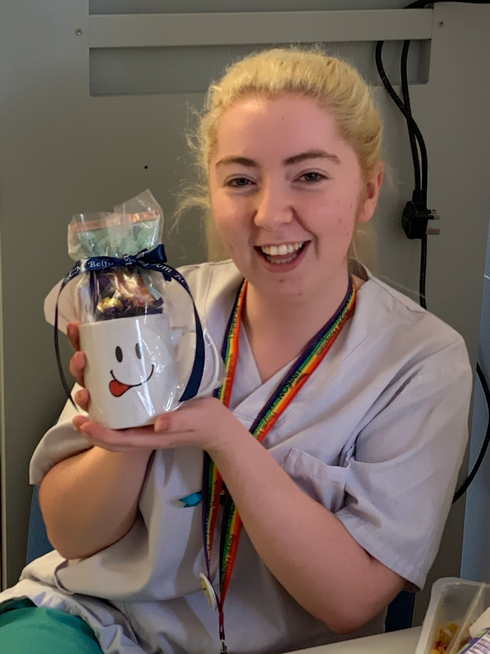

Caring For You
A

Slide 13

Thank you for listening – any questions ?

