Slide 1

Global strategic directions for nursing and midwifery; can we build better together and transfer evidence into reality in the European Region?
Mervi Jokinen MSc Dist, PGCert, BSc Hons, RM
Professional Advisor Royal College of Midwives UK
President European Forum for National Nursing and Midwifery Associations)
Former President European Midwives Association EMA/now Consultant
Grace Thomas FRCM
Head of Health Professions Cardiff University
Director of WHOCC for Midwifery Development

Slide 2

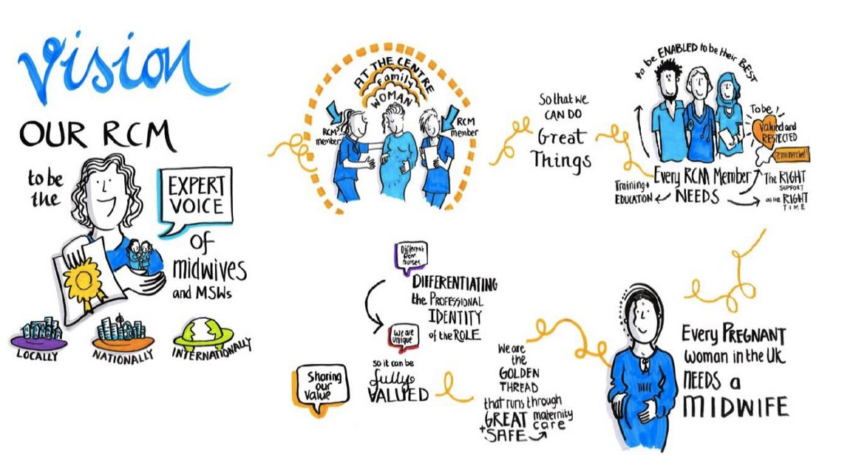
We use our role to promote, support and influence the development
of the midwifery profession
and high-quality maternity care internationally
Notes:
UK has a long history of being representatives of midwives 95% of midwives in the country are our members that is over 45.000 members, students, practising, retired midwives and in recent years maternity support workers we are both professional organisation and union so our influence is also on the working environment on which midwives practice.
We are visible as the voice of midwifery and invited to be around the table with policymakers, governmental organisations as well as developing evidence-based practice.
We use our role to promote, support and influence the development of the midwifery profession and high-quality maternity care locally nationally and internationally

Slide 3







The RCM engages internationally in three main areas:
REPRESENTATION & LEADERSHIP
ADVOCACY
We bring the voice of midwives to other professional organisations, NGOs, governmental bodies, and civil societies.
Voice of midwives is influential by holding leadership positions and advocate for safe SRMNAH for women & girls
TECHNICAL EXPERTISE
Expert advice in international and European projects and collaborations including policy, research, and dissemination
Notes:
Read through the 3 areas

Slide 4







Policy
The RCM international teamwork in Europe:
Research
EMA
WHO
CC
ICM
RCM
Collaboration
European
projects
Research
European
Forum for Nursing
& Midwifery
Associations
Advocacy
Notes:
These are examples of our partners within International work.

Slide 5
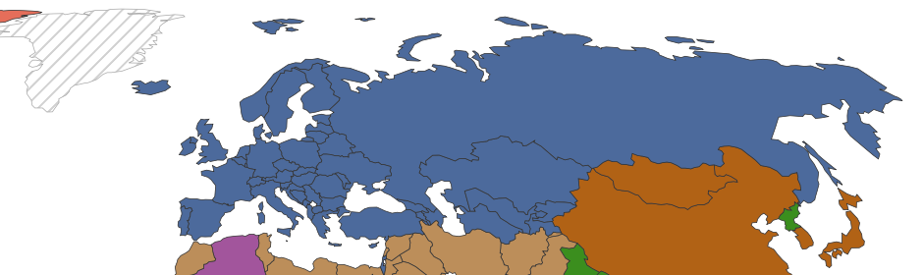
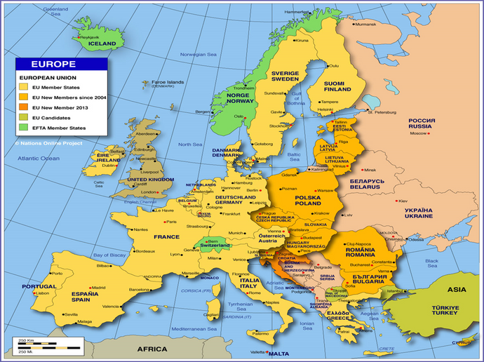

WHO EUROPEAN REGION
53 countries, covering a vast geographical
region from the atlantic to the pacific oceans.
Notes:
Europe’s two geographical areas in which RCM is involved with their own agendas. RCM can promote, support, and influence in midwifery as an individual organisation but even more actively as member of other European organisations EMA and EFNNMA.
This leads to some differences on what kind of activities are involved for example in EU over the years we have been engaged with the professional qualification Directive and other directives like cross border health care which legislative policies in all EU countries
WHO Europe develops Health strategies and action plans specific for WHO European Region, which are adopted or not, by member states representatives of Health Ministries who annually have to report data annually on indicators and compliance with strategies to WHO.

Slide 6

Increased maternal age, obesity, infertility treatments,
medical complications, perinatal mental health
Challenges in WHO European Region
Population
needs
Humanising birth as life event
Patient safety
includes emotional safety
Human
rights
Care for pregnant
refugees, migrants,
asylum seekers
Migration
Careful resource management
skill mix and use of
technology
Gender
inequalities
Women and midwives –
health literacy / status at work
Resources
Notes:
Population needs Increased maternal age, obesity, infertility treatments, medical complications, perinatal mental health
Migration Care for pregnant refugees, migrants, asylum seekers
Gender inequalities Women and midwives – health literacy / status at work
Resources Careful resource management skill mix and use of technology
Human Rights Humanising birth as life event Patient safety includes emotional safety

Slide 7

Health system delivering care
Woman-centred respectful care is one of our key priorities
It should mean the women can gain greater control over decisions and actions affecting their health during their pregnancy and childbirth
We often see when women are asking for different care package it may be provided by private care but not public health care – therefore increasing inequality
Absence of midwives in primary care teams and in some countries in the health system itself
A
Notes:
But it is not just the clinical practice we have to be aware of our influence has to reach the heart of the health systems so that the environment midwives practise their role and secure a role distinction from other health professional and question what is happening in our region.
Slide text

Slide 8
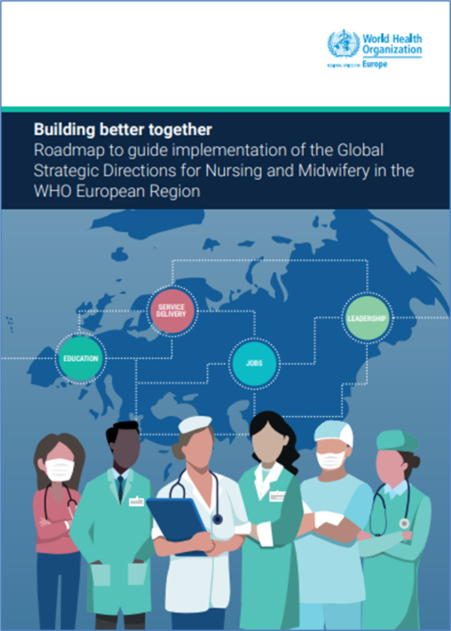





Leadership
Education
Jobs
Service delivery
EURO Regional Roadmap for nursing and midwifery (2021)
Notes:
RCM WHO Cardiff and EFNNMA were in the core group of developing the Building better together: roadmap to guide implementation of the Global Strategic Directions for Nursing and Midwifery in WHO European region. The document aims to harmonise education, support Leadership and strengthen jobs and service delivery in all member states. The distinction between midwifery and nursing education for example is strengthened in the policy and stated expected indicators.
Leadership
A key strategic direction in the European Region for midwifery associations
A drive to establish Midwifery leadership in all levels of Health systems/structures
Recognised in the SoWMy report 2021
Separate from Nursing Leadership i.e. national and regional level Chief Midwifery Officer (CMidO)
RCM manifesto

Slide 9
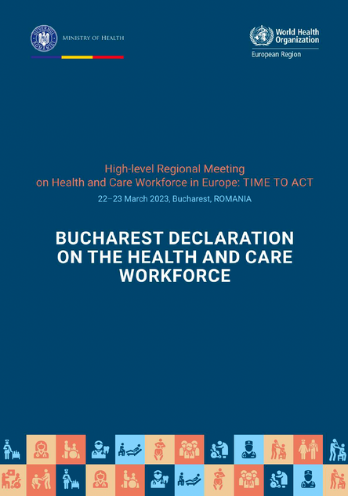
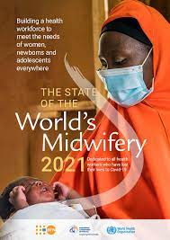

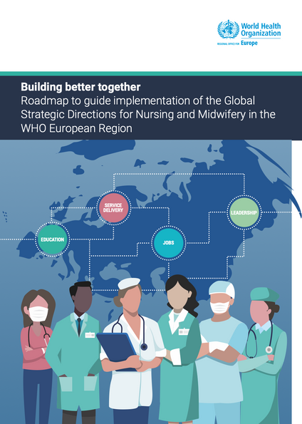
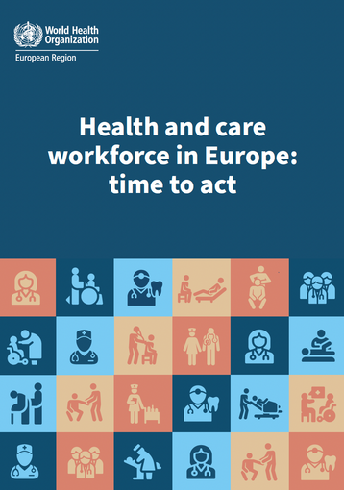
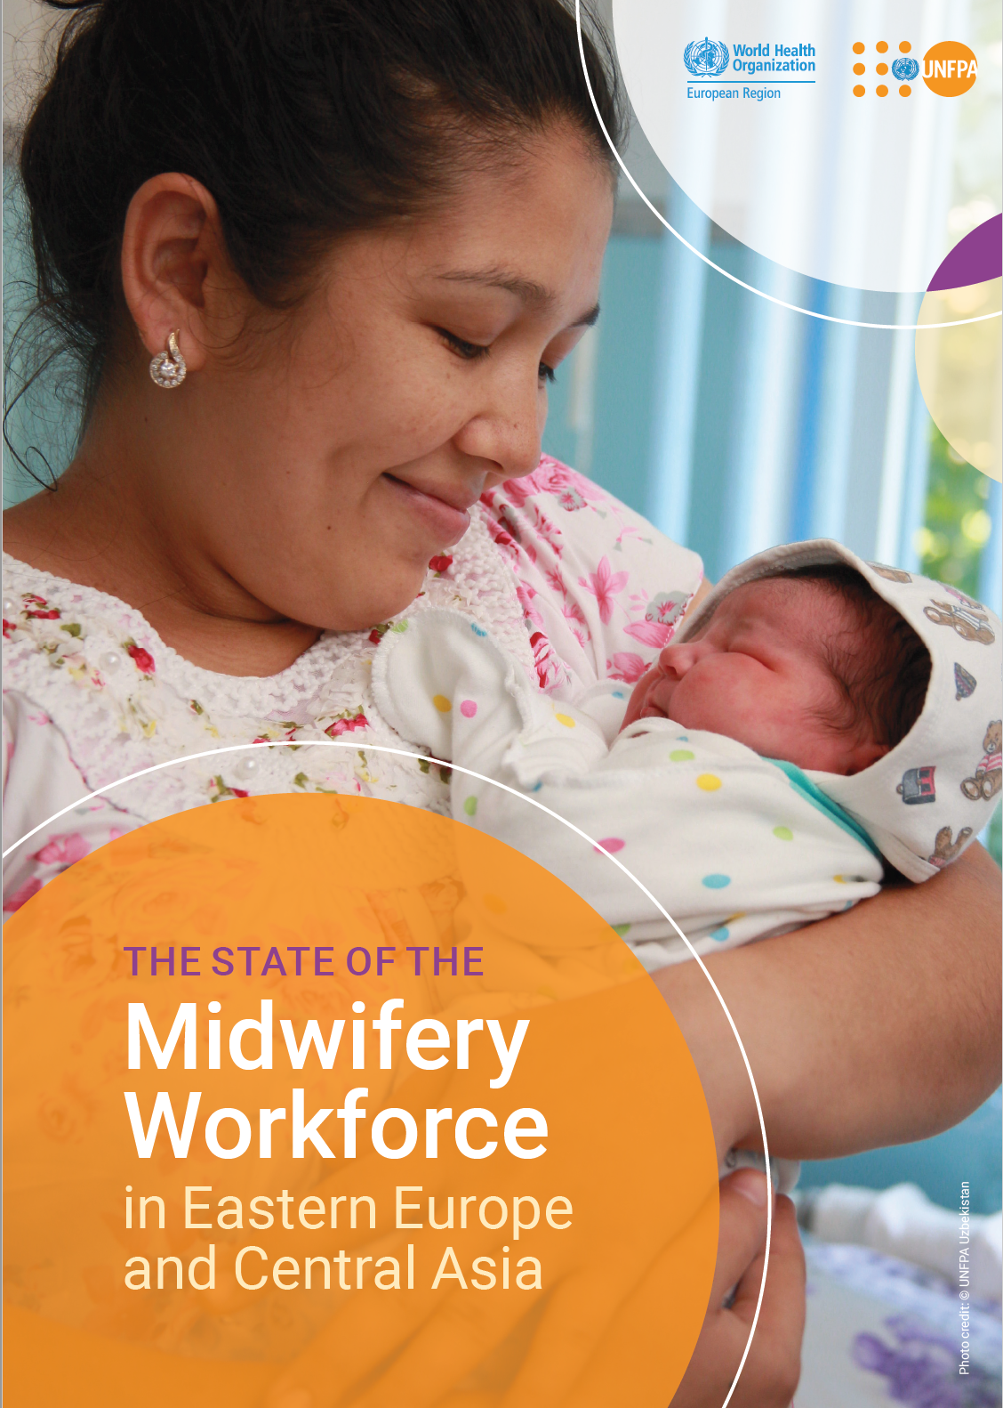
Notes:
These documents recently published by WHO Europe with midwifery advice and input are supportive of the new environment in which we can flourish. They in content reflect the GSDNM

Slide 10
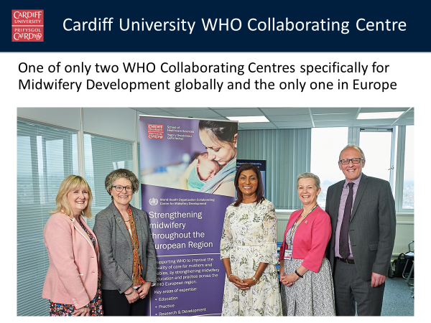

Slide 11

What does the WHOCC do?
We support WHO Europe in scaling up and transforming midwifery education across 53 member states of Europe.
Why? TO IMPROVE CARE FOR MOTHERS & BABIES
By:
Strengthening the evidence base on midwifery education
Assisting WHO in capacity building and strengthening midwifery education

Slide 12

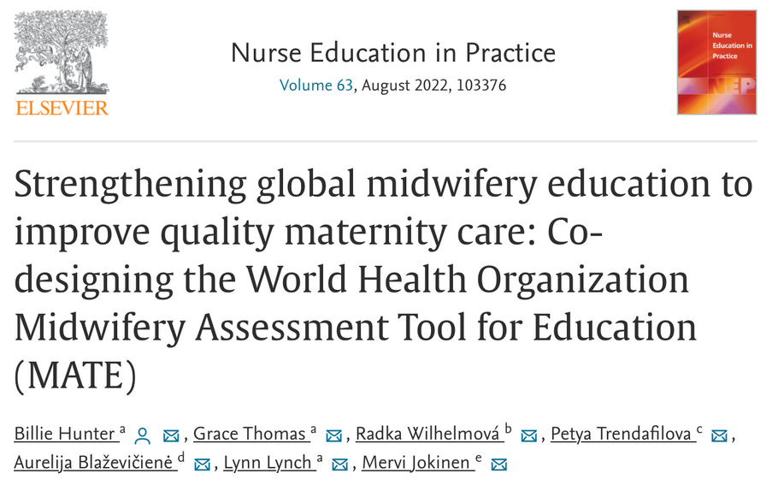
Midwifery Assessment Tool for Education MATE
https://www.euro.who.int/en/health-topics/Health-systems/nursing-and-midwifery/publications/2020/midwifery-assessment-tool-for-education-mate-2020

Slide 13
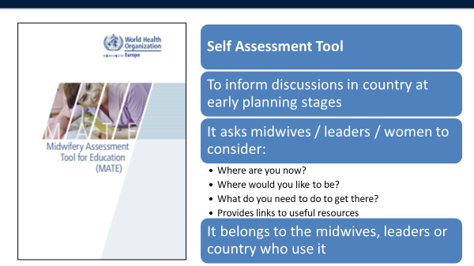
MATE

Slide 14
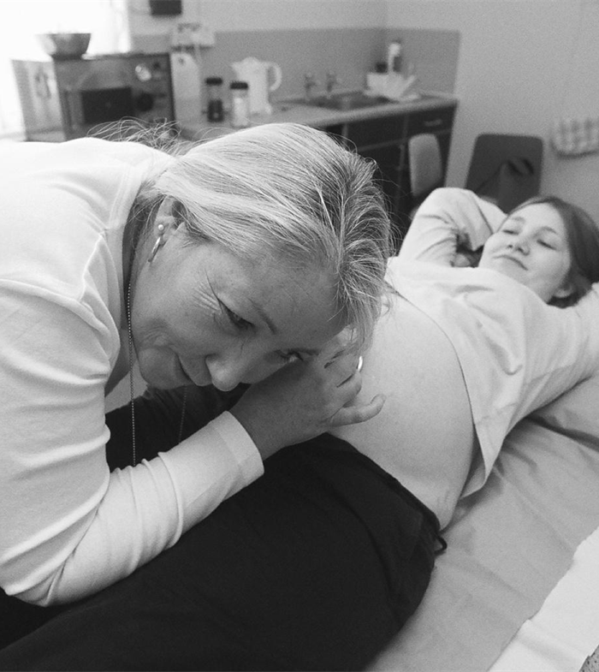
Partnership working and leadership
Harmonising regulation, education and workforce data across a large region, in spite of national member state challenges, can be strengthened by collaborative work between Midwifery Associations and WHO regional leaders.
The evidence is clear:
“Midwifery is a vital solution to the challenges of providing high-quality maternal and newborn care for all women and newborn infants, in all countries”
(Prof Mary Renfrew The Lancet June 2014 Executive Summary)
A

Slide 15


