Slide 1
Caring for vulnerable migrant women
RCM toolkit

Slide 2
A UK stark reality…
Characteristics of the women who died 2017-2019:
2 refugees or asylum seekers, 6 women with another or unknown citizenship status
Maternal mortality likelihood:
Black women X 4
Mixed ethnicity X 3
Asian (especially Bangladeshi & Pakistani) X 2
(MBBRACE-UK, 2021)
Worse pregnancy-related indicators in migrants are found across the European region, including pre-term birth, perinatal and neonatal mortality and morbidity (WHO, 2018)

Slide 3
Migration – the context
48,540 asylum applications in the UK during the last 12 months
Up by 63% from the previous year
People seeking asylum receive little financial support and are not allowed to work
100,564 cases are currently awaiting decision
Newly granted asylum seekers often face destitution and homelessness
Maternity care is chargeable in the UK

Slide 4
Care costs…
Apply to hospital and community maternity services
150% of the standard tariff (explicitly ‘a profit-making element’)
A bill for birth amounts to £7000, sometimes more
Women are reported to the Home Office if they do not pay
Incentives and sanctions support NHS in identifying chargeable visitors & migrants – creating a hostile environment
Administration of charging system circa £15 million, equivalent to the amount recovered
Unintended consequences for women needing care …

Slide 5
Long term costs
What are the implications for an individual’s immigration status if debts remain outstanding?
https://vimeo.com/140799841
The Working Academy at the University of Bradford

Slide 6
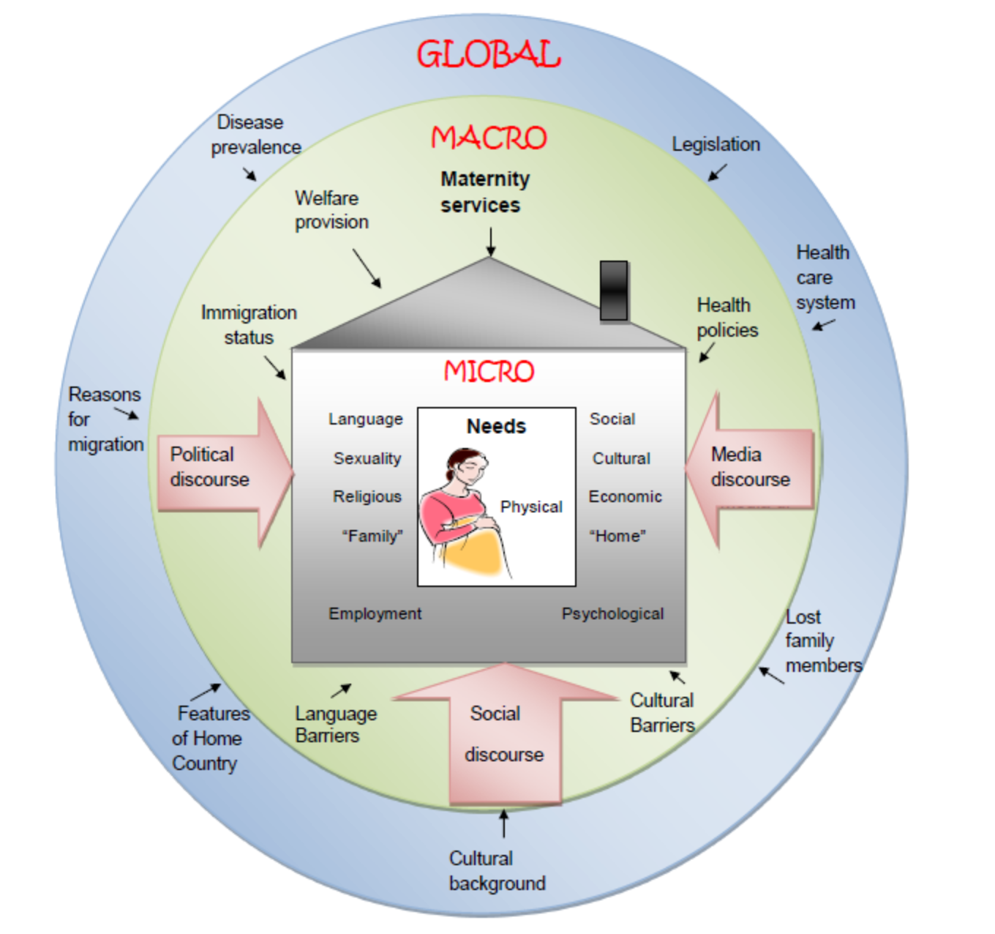
Model showing the pregnant woman within the global context Haith-Cooper M, Bradshaw G (2013): The Pregnant Woman within the Global Context

Slide 7
Care concerns for the RCM
Particular needs of vulnerable migrant women
(living conditions, mental health, trauma and FGM)
Communication – access to timely interpreting
Managing risk and safety
Dispersal / relocation
Financial dependency
Practical resources
Language barriers - https://vimeo.com/140799700
The Working Academy at the University of Bradford

Slide 8
Professional concerns for the RCM?
The same questions must be asked of every single patient, in every single department, whose chargeable status is not known:
"Where have you lived in the last 6 months?”
If the UK only, no further action
If outside the UK, or UK plus other country, then ask: -
“Do you have a EHIC or other document to show that you’re entitled to free NHS care?”
If a non-UK issued EHIC is provided, take details from the card Regardless of the answer or documents provided in answer to the second question,
Inform the OVM that the patient may be an overseas visitor
Inform the patient they may be interviewed to check entitlement
Guidance on implementing the overseas visitor charging regulations (DHSC, 2021)

Slide 9
How do we, as midwives, feel about this?

Slide 10
NMC Code
“Share necessary information with other health and care professionals and agencies only when the interests of patient safety and public protection override the need for confidentiality”

Slide 11
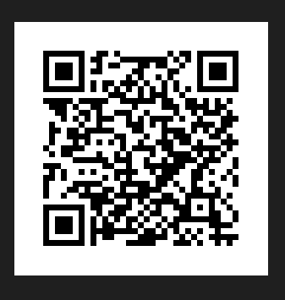
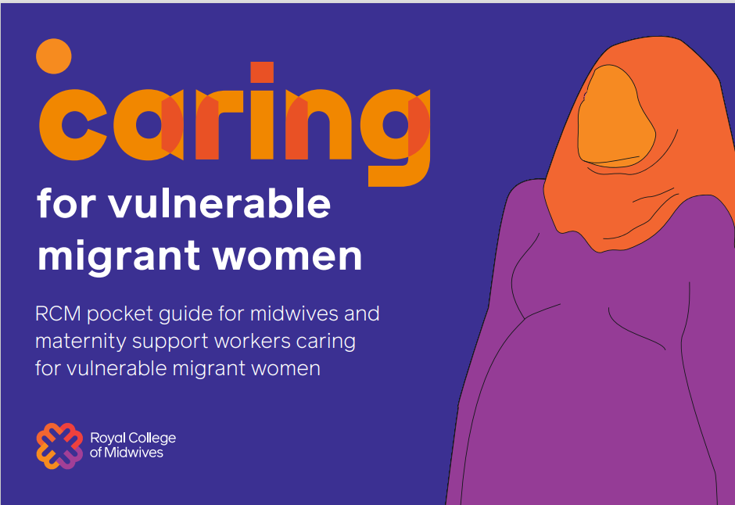
Guidance for midwives

Slide 12
What about policy?
www.rcm.org.uk/media/5850/rcm_position-statement_caring-for-migrnt-women.pdf

Slide 13
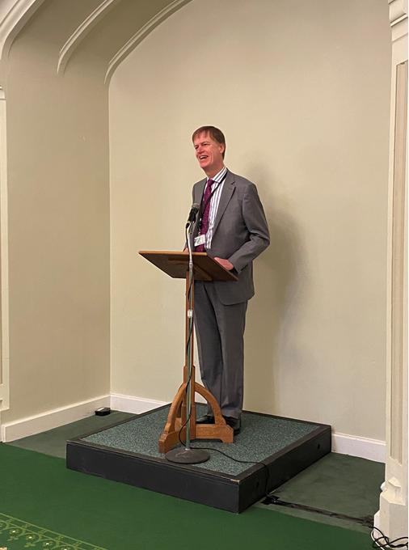
Parliamentary lobbying

Slide 14
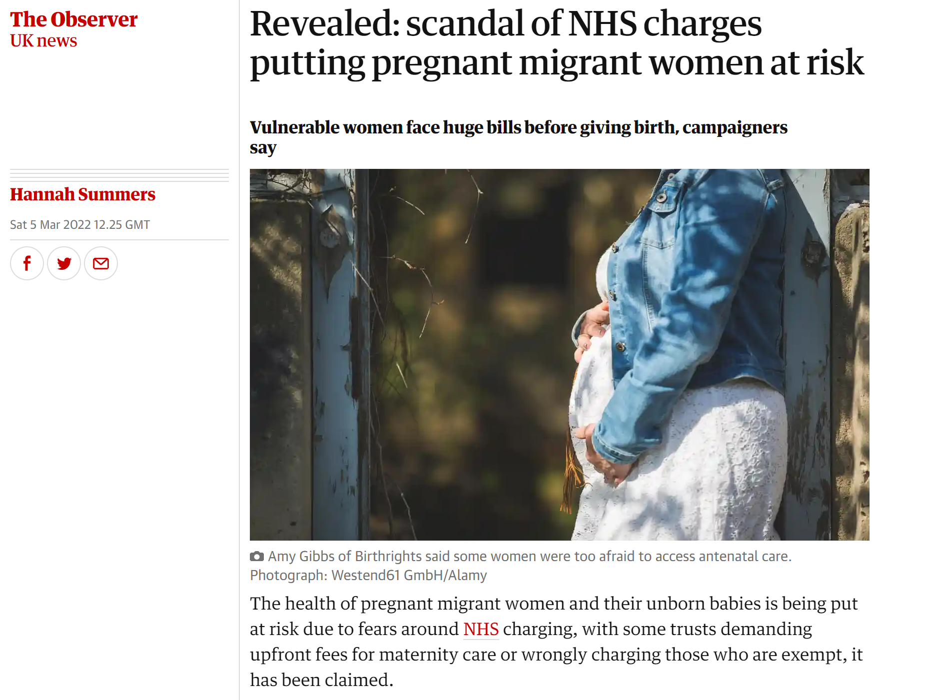
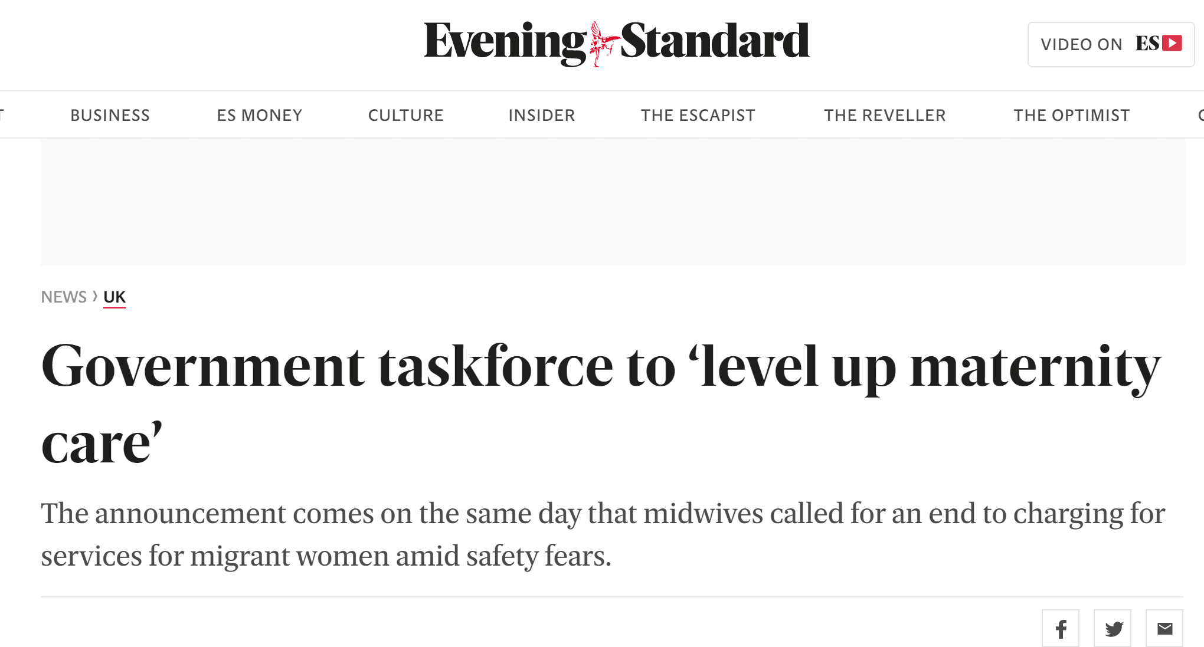
Media relations

Slide 15
RCM ilearn module
Understanding asylum seekers and refugees
1.5 hours study time
To develop insight into the life of a pregnant woman who is seeking asylum or who is a refugee

Slide 16
For more information contact:
Clare.Livingstone@rcm.org.uk

