Slide 1


The Re:Birth project
Birte Harlev-Lam OBE
Executive Director Midwife

Slide 2


What the project was (and wasn’t)
  An open, collaborative process to build a consensus about the names we call different types of birth in the UK
  Producing practical, accessible resources for maternity and service user organisations
  Not focused on inclusive language, wider concerns about language or care practices in maternity care

Slide 3

Why undertake Re:Birth?
  Negative narrative in reports and media about the focus on ‘normal birth’ in the UK
  Reports from women and service users that they find the term ‘normal birth’ difficult as it may suggest their birth was ‘abnormal’

Slide 4


“There should be no hierarchy of birth. Women and their babies require respect, care and safety to navigate pregnancy and then both during and after labour. It should be an empowering experience and not dependent on a value placed on a ‘type’ of birth or impacted by a sense of failure due to not meeting the desired birth” (Service User)
We heard the views of 7822 people

Slide 5
Values of the Re:Birth project
Collaboration:
we want to work with everybody involved with or who cares about birth
Inclusivity:
we would rather include more voices than exclude
Openness:
we are open to any outcome
Listening:
we prioritise listening
Evidence-based:
we will ensure the process is rigorous and evidence-based

Slide 6






















Our project oversight group
Notes:
SANDS, Birth Trauma Association, NCT, NMC, AIMS, Maternity Engagement Action, Five X more, Make Birth better and Birthrights; RCOG, NMPA, ICM NHSE, LME Network, RCM Consultant Midwives Network, Obstetric Anaesthetists’ Association, Independent chair was Shirley Cramer CBC

Slide 7
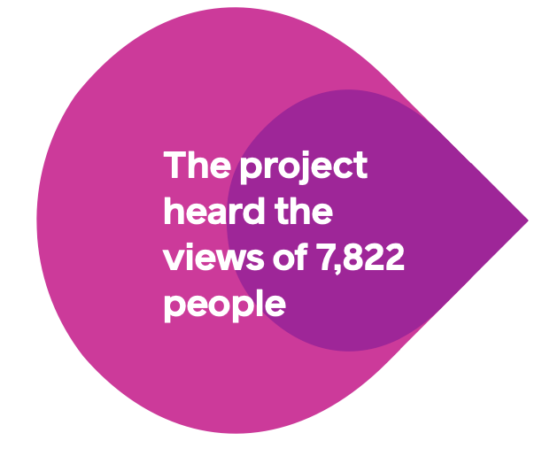
Methods: from October 2021 – April 2022
12 online mixed listening groups (midwives, obstetricians, service users, doulas, obstetric anaesthetists, MSWs, student midwives, service user support organisations) – including 110 people
764 responses to the Voices Survey
6948 responses to the final online survey
Analysis of history of ‘normal birth’ in NMC Rules and Standards (1980-2022) and key maternity care policy documents (1993-2022)
We heard the views of 7822 people

Slide 8

How representative were the Re:Birth project participants?
  12% from global majority group (compared to 14% of UK population) 72% of survey participants were White British or Irish background
  Celtic nations (Northern Ireland, Scotland, Wales) were slightly over represented compared to England
  Deprivation: we asked for postcodes – all quintiles were represented in the survey, though least deprived more so

Slide 9
Themes from the qualitative parts of the project: listening groups and voices survey
  A shared vision for labour and birth to be physically and psychologically safe
  Language matters
  There is confusion and frustration about different interpretations of language
  Concern about a perceived hierarchy that normal = best
  Feelings of failure – exacerbated by language, particularly for those with difficult labour and birth experiences
  All terms were problematic for some people
We heard the views of 7822 people

Slide 10

We asked health professionals:
When the women and families you care for are later talking about their labour and births, what one word do you hope they use?

Slide 11

Other difficult language
Although we did not ask, women were keen to tell us about other language in maternity care that they found difficult:
Failure or failed:
Depersonalising language: ‘The induction in bed 4’, ‘the labourer in room 2’
Blaming language: ‘poor maternal effort’, ‘refused’
Centering the professional: ‘I will consent her’, ‘I delivered her’,
Infantalising language: ‘good girl’, ‘you are allowed/not allowed’
We heard the views of 7822 people
Notes:
Although we did not ask, women were keen to tell us about other language in maternity care that they found difficult:
Failure or Failed: “I was introduced as the ‘failed home birth’, I had a ‘failed induction’ with ‘failure to progress – so there was lots of the word ‘failure’ on my notes and being used around me”. ‘Incompetent’ cervix was also felt to have connotations of personal failure.
Depersonalising language: Some women described recent experiences where language that dehumanised them was used : ‘The induction in bed 4’, ‘the labourer/niggler in room 2
Blaming language: ‘poor maternal effort’, ‘refused’
Centring the professional: ‘I will consent her’, ‘I delivered her’,
Infantalising language: ‘good girl’, ‘you are allowed/not allowed’
12

Slide 12
The requirements for a shared language
Service users have asked for terms to describe labour and birth that are:
  Descriptive and technically accurate
  Non-judgmental, non-hierarchical, nor value-laden
  Reflect their actual experience, not what is assumed her experience is by others.
Health professionals need terms that are:
  Consistently understood between individuals and professional groups
  Clear, descriptive and unambiguous
  Allow for the identification of some granular differences in the mode of labour and birth (e.g. ‘vaginal’ would not be distinctive enough).

Slide 13


Preferred terms for types of birth
Overarching preferred term for all types of birth was birth rather than delivery or section.
The two sub categories of birth preferred were:
vaginal birth and
caesarean birth.
Notes:
Both ‘unplanned’ (n=4733) and ‘in-labour’ (n=4664) were popular terms amongst the Final Survey respondents to describe this type of caesarean birth. Obstetricians preferred 'in-labour' whilst other groups preferred 'unplanned'. We recognise the shortcomings of both. The Project Oversight Group supports the use of either term where appropriate, especially ‘unplanned’ in conjunction with 'planned caesarean birth'.
20

Slide 14
Preferred terms: professional notes, research & audit
Spontaneous Vaginal Birth (n=5020, 89%)
Birth with Forceps (n=5314, 93%)
Induced and/or augmented labour (n=5157, 89%)
Unplanned caesarean birth (n=4733, 83%);
(‘In-labour’ was also popular (n=4664, 82%))
Planned caesarean birth (n=5761, 99%)
Caesarean birth (n=5560, 97%)
We heard the views of 7822 people
(n=number of survey participants who preferred or didn’t mind the term, % of survey respondents)
Notes:
Both ‘unplanned’ (n=4733) and ‘in-labour’ (n=4664) were popular terms amongst the Final Survey respondents to describe this type of caesarean birth. Obstetricians preferred 'in-labour' whilst other groups preferred 'unplanned'. We recognise the shortcomings of both. The Project Oversight Group supports the use of either term where appropriate, especially ‘unplanned’ in conjunction with 'planned caesarean birth'.
20

Slide 15
Key findings of Re:Birth
Language has a significant influence on care and experience. Getting the language as right as possible is part of of personalised care.
Service users have asked for terms that are:
  Descriptive and technically accurate
  Non-judgmental, non-hierarchical, non value-laden
  Reflect their actual experience, not what is assumed her experience is by others
  Health professionals should personalise their care to women’s language preferences.
  In all circumstances, the following principles were preferred:
  To use birth, rather than ‘delivery’ or ‘section’
  To be clear and specific: e.g. ‘induced/augmented labour’ rather than ‘labour with interventions’
Notes:
Language is an important aspect of care and experience
Service users have asked for terms to describe labours and births that are:
Descriptive and technically accurate
Non-judgmental, non-hierarchical, nor value-laden
Reflect their actual experience, not what is assumed her experience is by others
Health professionals should ask women what language they would like them to use to describe different types of birth and personalise their care to women’s preferences
When having interprofessional conversations, writing notes and in audits and other reports, the recommended language should be used:
Spontaneous vaginal birth
Birth with forceps or ventouse
Augmented /Induced labour
Planned /unplanned caesarean birth
27

Slide 16
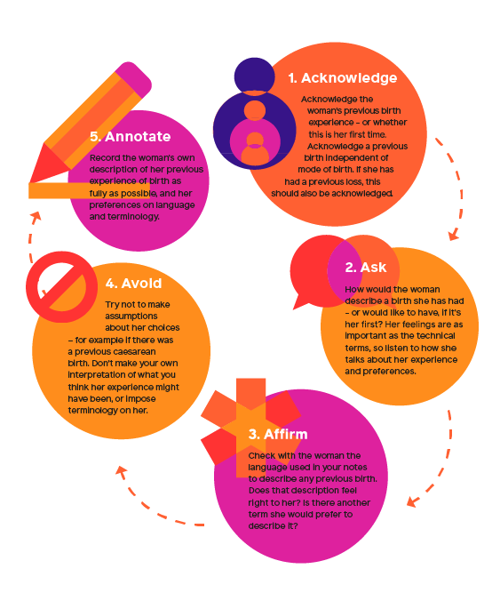
Personalised care conversation starter
We heard the views of 7822 people

Slide 17

It is the midwife’s role to promote positive outcomes and prevent complications
Midwives are best placed to support the psychological and physiological processes of labour and birth.
They maximise the opportunity for women to have a safe and holistic experience and optimise the opportunity for every woman to feel that giving birth, by whatever means, is an achievement.
We heard the views of 7822 people

Slide 18
Acknowledgements
Re:Birth is a collaborative project led by the Royal College of Midwives, working with representatives from across maternity care, including staff, advocacy groups and service users.
As well as the many thousands of people who took part in the Listening Groups and Voices Surveys, the project was supported by a project oversight group, alongside those who supported the management of the research.

Slide 19
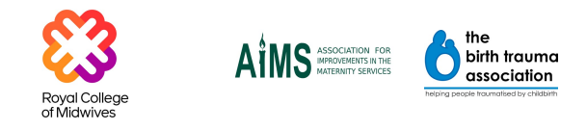
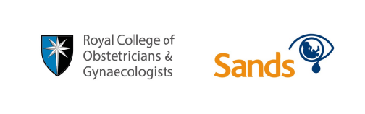








Contributing organisations
We heard the views of 7822 people
UK Consultant Midwives Network

Slide 20

Birte Harlev-Lam:
Birte.Harlev-Lam@rcm.org.uk

