Slide 1


Midwifery-led settings provision in the UK during the COVID-19 pandemic: a survey of practice and provision conducted by the Royal College of Midwives
Lia Brigante, RM, MSc

Slide 2


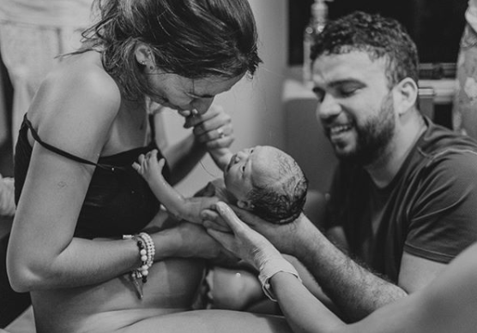
Context - place of birth in the UK
  National guidance on care for healthy women and their babies during birth recommends that women are advised that they may choose any birth setting.
  Recommendations are based on the Birthplace study.
  All women and birthing people should have a personalised care and support plan including PoB.

Slide 3
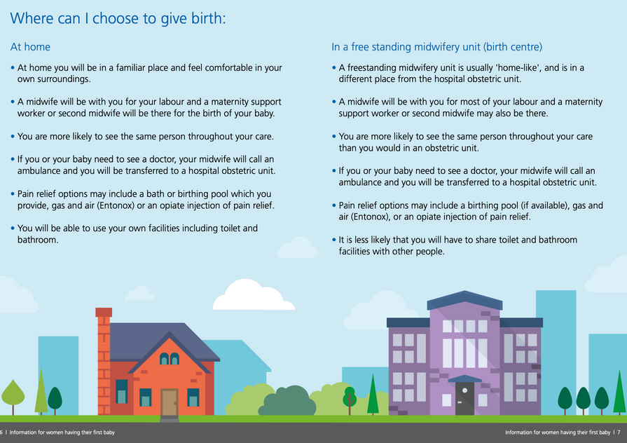

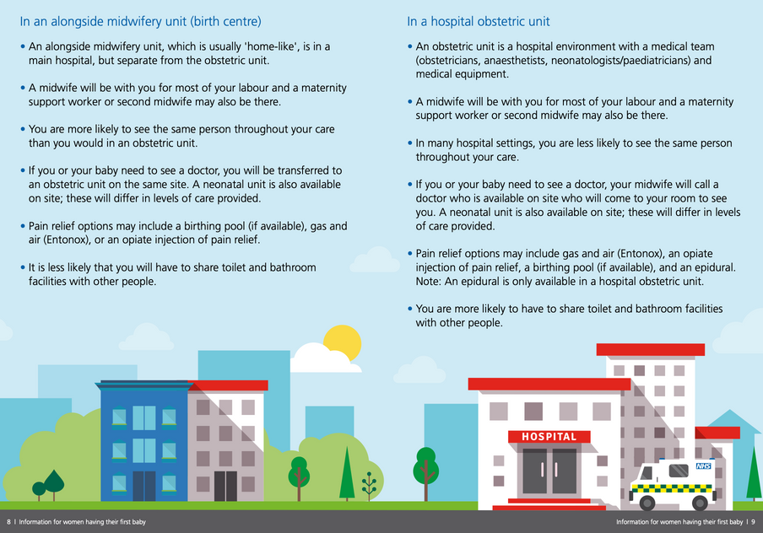
Place of birth options
  Homebirth
  Freestading Midwifery Unit
  Alongside Midwifery Unit (hospital based)
  Obstetric Unit (hospital based)
  There is variation of midwife-led settings provision across the UK nations and regions.

Slide 4



Impact of the pandemic PoB
Optimising maternity services and maternal and newborn outcomes in a pandemic. Rapid review conducted by the professorial group.
  Women and newborn babies, as far as possible during the pandemic, require access to quality midwifery care, multidisciplinary services and to additional care for complications and emergencies if needed.
  When staff and services are under extreme stress there is a real risk of increasing avoidable harm, including an increased risk of infection, morbidity, mortality and reductions in the overall quality of care.
  Safety, quality and preventing avoidable harm must be key priorities in decision-making.
  Continuation of as near normal care for women should be supported, as it is recognised to prevent poor outcomes.
ICM recommends that in countries where the health systems can support homebirth, healthy women experiencing a low-risk pregnancy may benefit from giving birth at home or in midwife-led units rather than in a hospital where there may be many COVID-19 patients, if there is the ability to provide appropriate midwifery support and appropriate emergency equipment and transfer.
@lia_bri

Slide 5

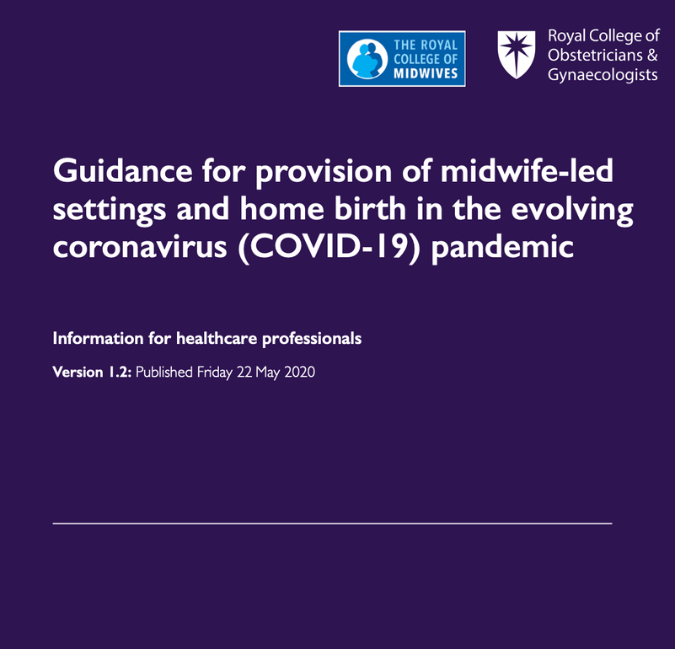
Joint guidance on midwife-de settings provision
  Unique population, the majority are healthy, experiencing a life event that, brings physical, emotional, psychological and social needs.
  Guidance developed to support maternity service leads in decision making about midwife-led birth settings in the evolving coronavirus pandemic.
  Model based on:
Available midwifery staffing
Skill mix of available
midwifery staffing
Availability of ambulances and
paramedic staff, to provide emergency transfer
Bed occupancy in the maternity unit(s)
Community workload
Sickness rate among midwifery staff (midwives, maternity support workers and senior student midwives)

Slide 6
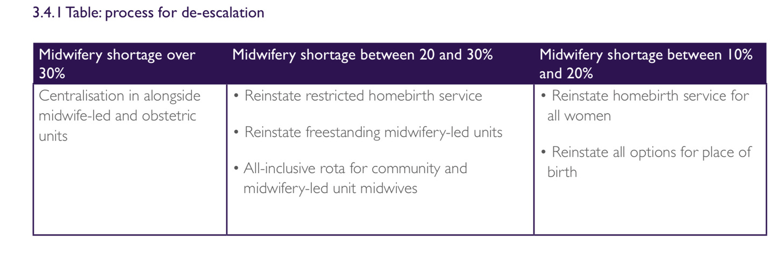
Joint guidance on midwife-de settings provision
  Phase 1: Preparation midwifery shortage at 10-20%/ ambulance as usual.All place of birth available for as long as possible
  Phase 2 midwifery shortage at 20-30%/minor delays. Restricted homebirth service and prioritising Alongside midwifery units birth. Scale up n.of rooms in AMU.
  Phase 3: Centralisation midwifery shortage >30%, severe delays. AMU centralisations and midwife-led care to be provided on AMU and/or OU.
  Phase 4: De-escalation

Slide 7

Impact of the Covid-19 pandemic on midwifery-led service provision in the UK
To describe changes to midwifery-led service provision in the United Kingdom and the Channel Islands during the COVID-19 pandemic.
Three national surveys were circulated using the United Kingdom Midwifery Study System (UK- MidSS) and the Royal College of Midwives (RCM) Heads and Directors of Midwifery Network.
RCM survey
(April 2020)
The UK- MidSS surveys took place in wave 1
(April to June 2020)
and in wave 2 (February to March 2021).

Slide 8

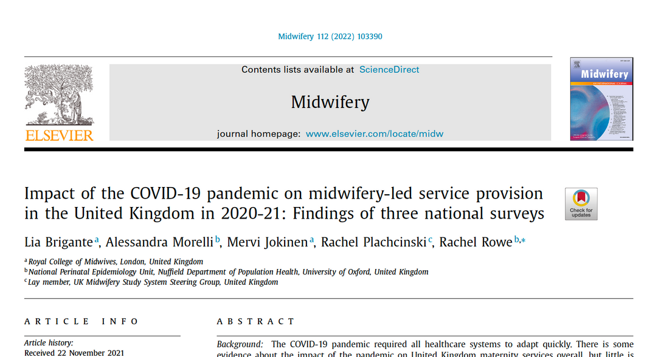
Data collection
midwifery staffing
and shortages
provision of homebirth
and midwifery-led settings
The RCM survey included open and closed questions
waterbirth
antenatal and
postnatal care
reports of
freebirthing

Slide 9
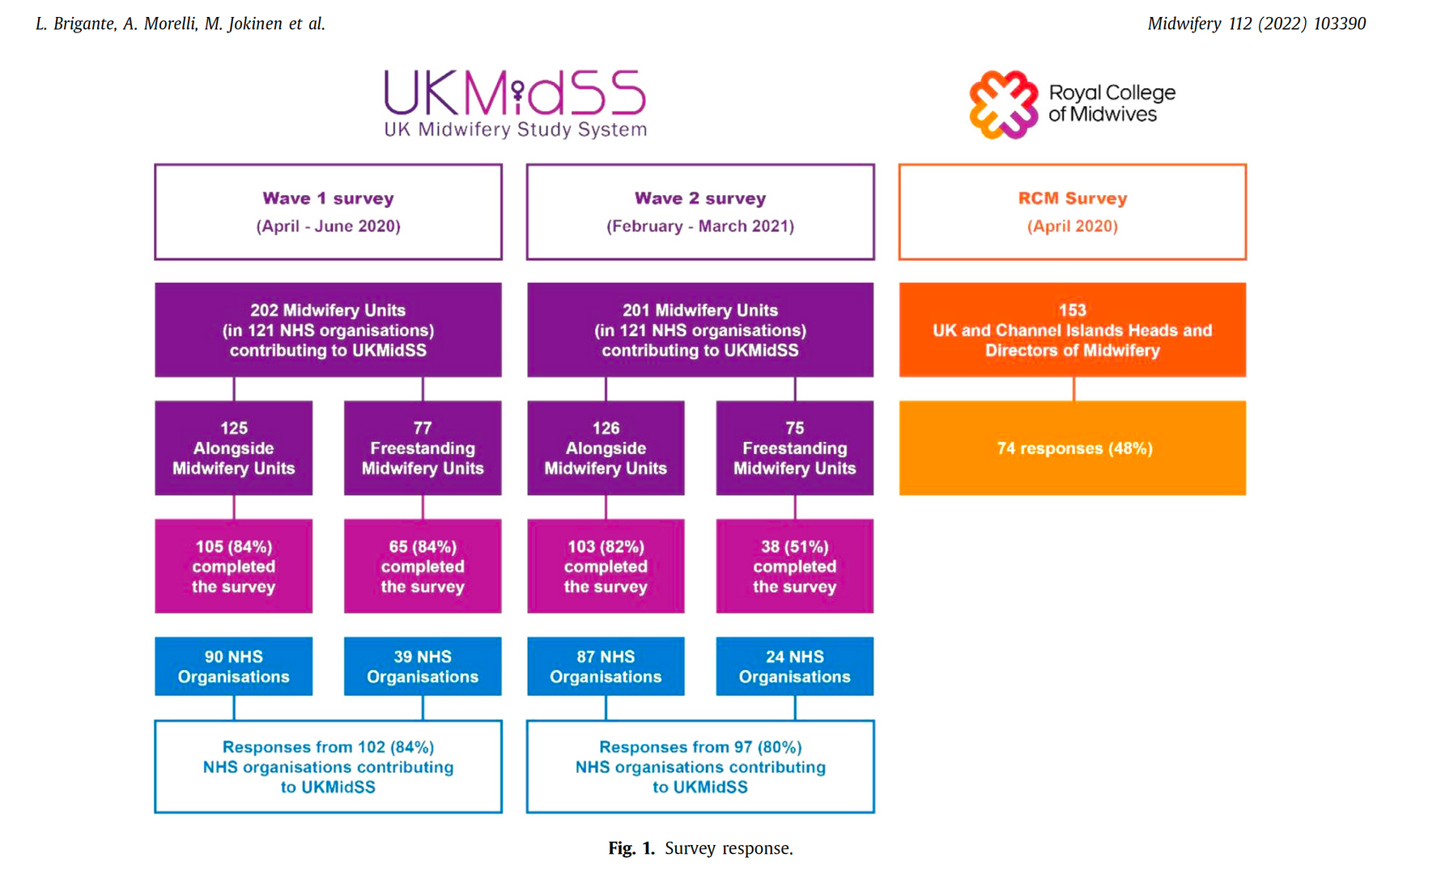

Slide 10
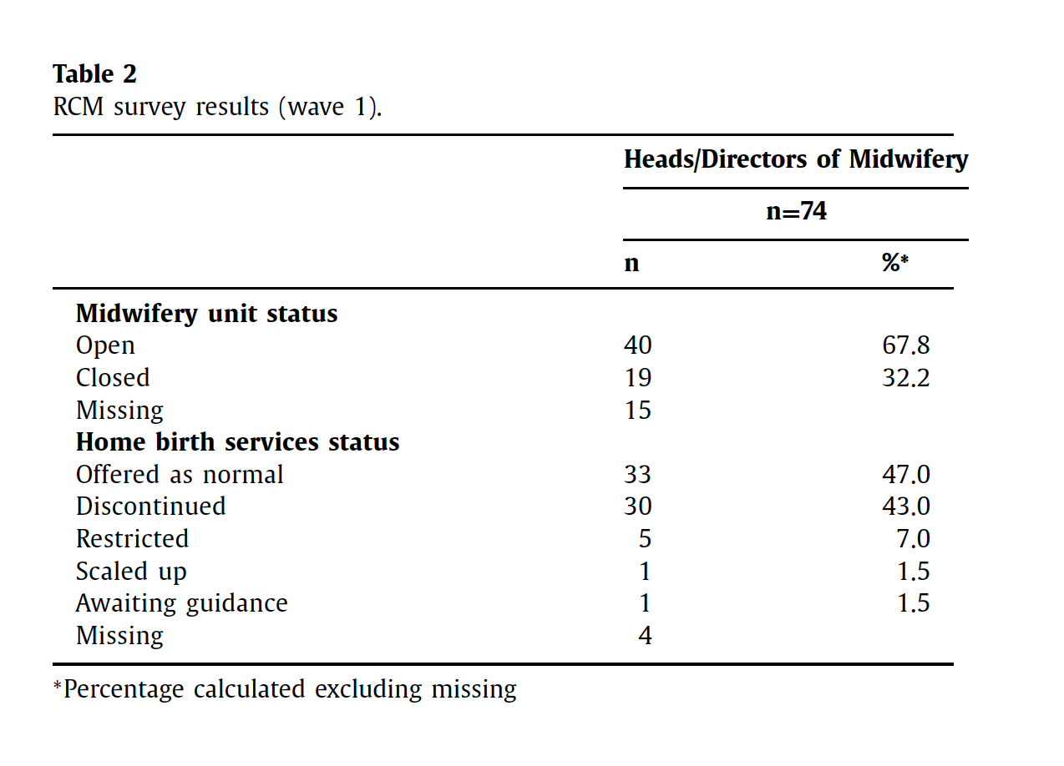
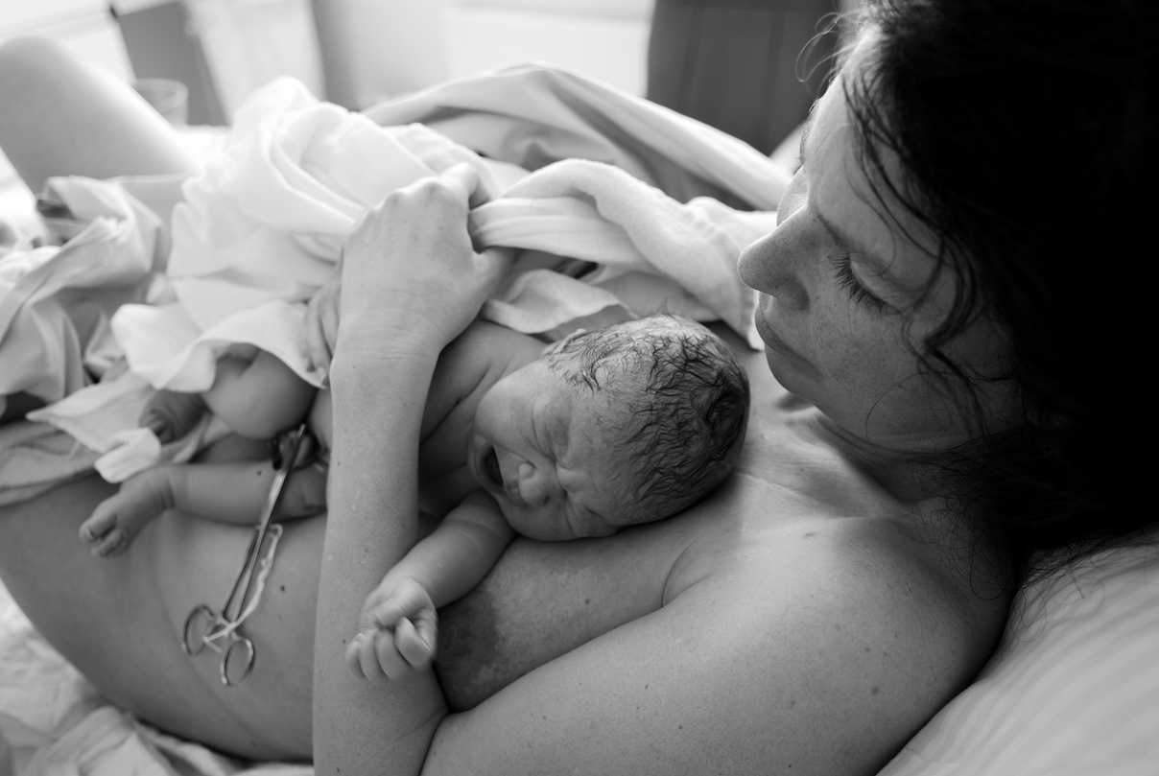
Provision of midwife-led settings
RCM survey results (wave 1)

Slide 11
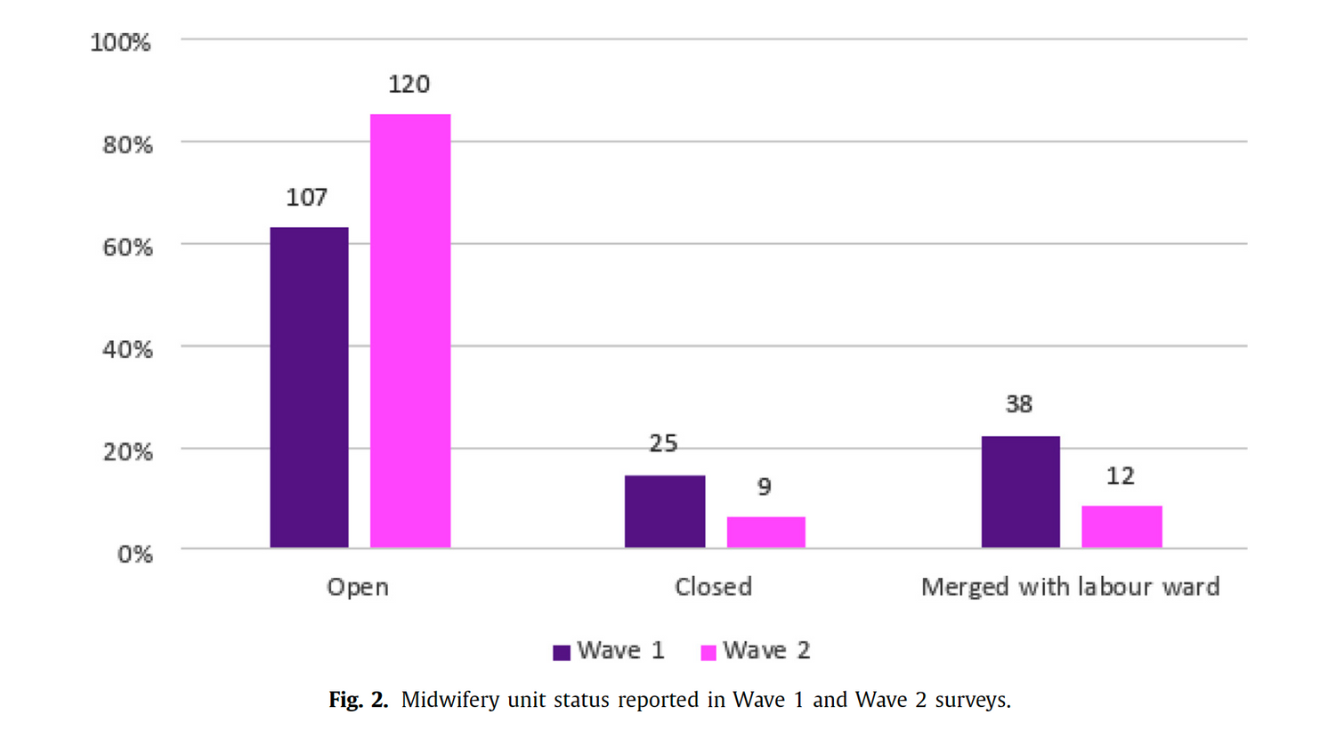
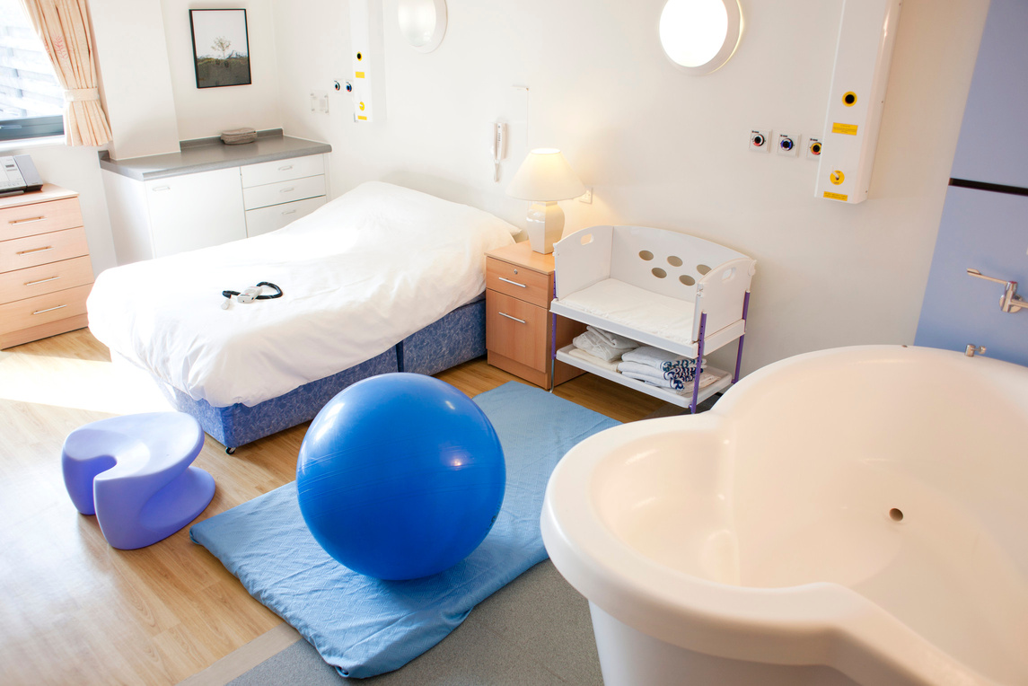
Midwifery unit closures

Slide 12
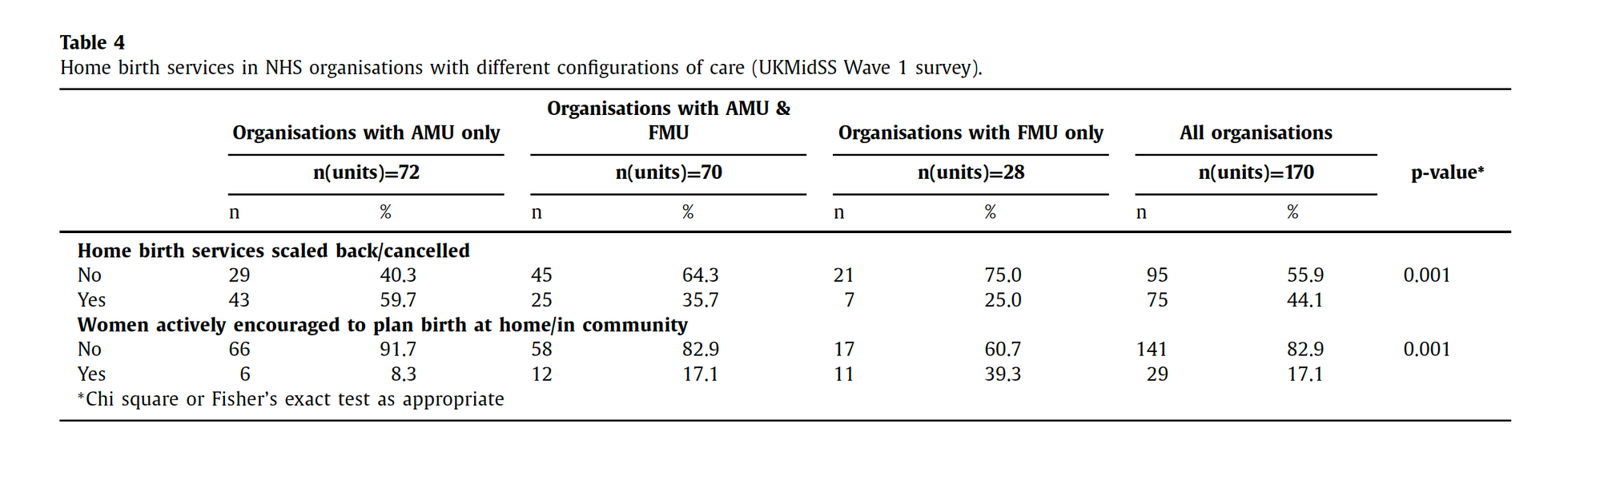
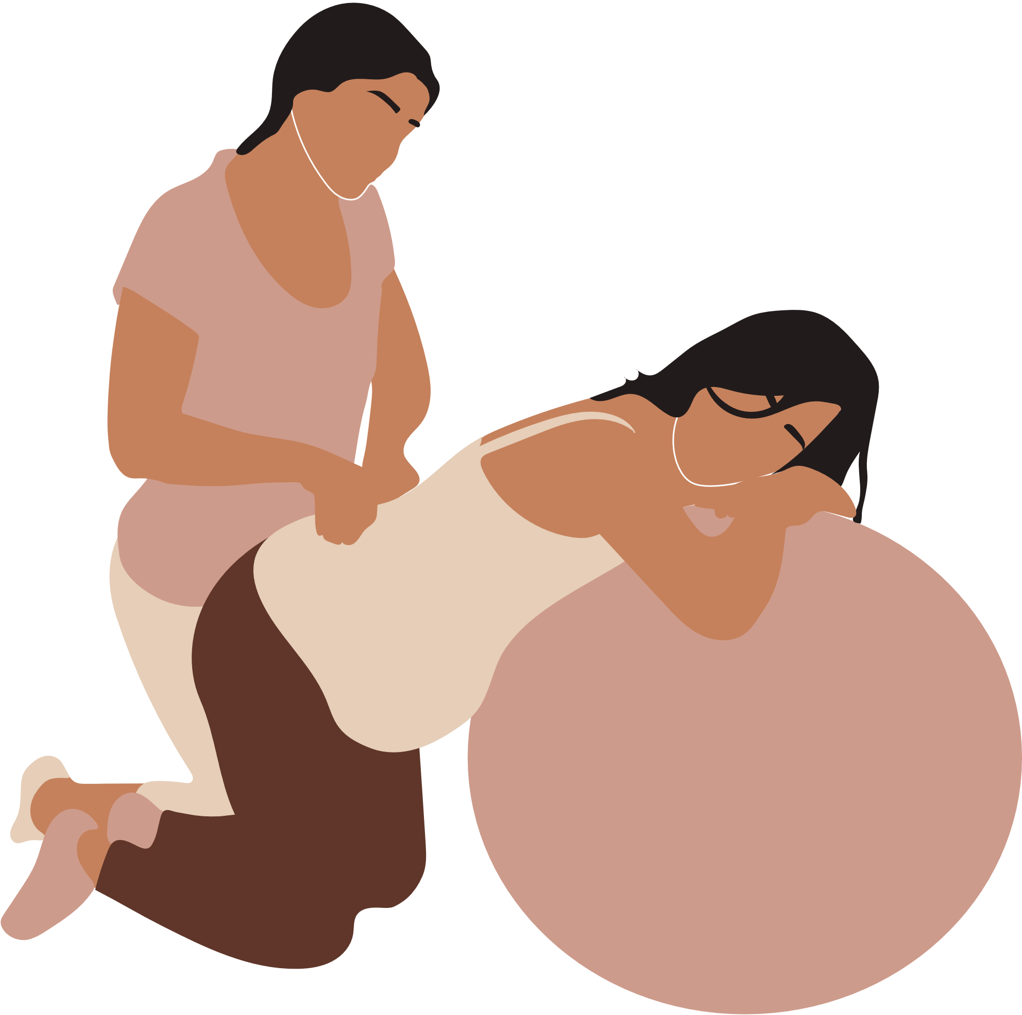
Homebirth provision

Slide 13
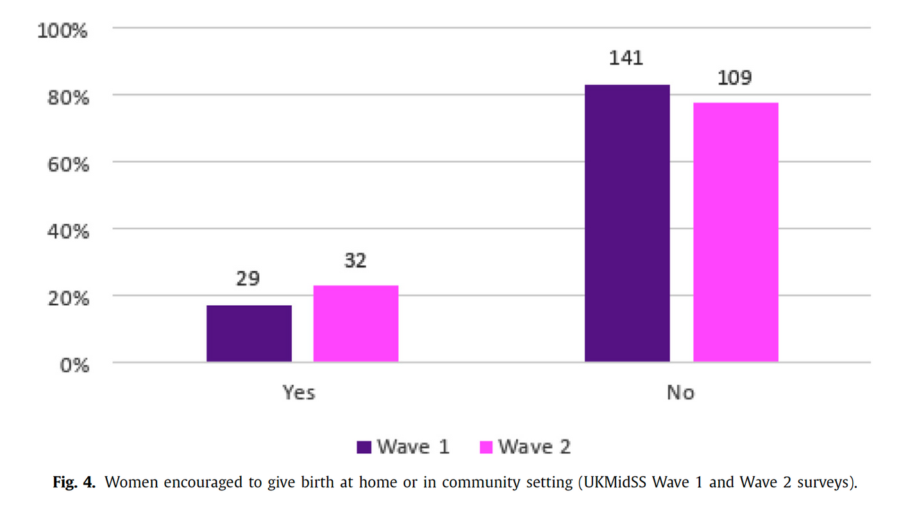

Women encouraged to give birth at home or in community settings

Slide 14

Concerns on service provision from RCM survey free text
Midwives safety and wellbeing
Demand for homebirth
Staffing Shortages

Slide 15
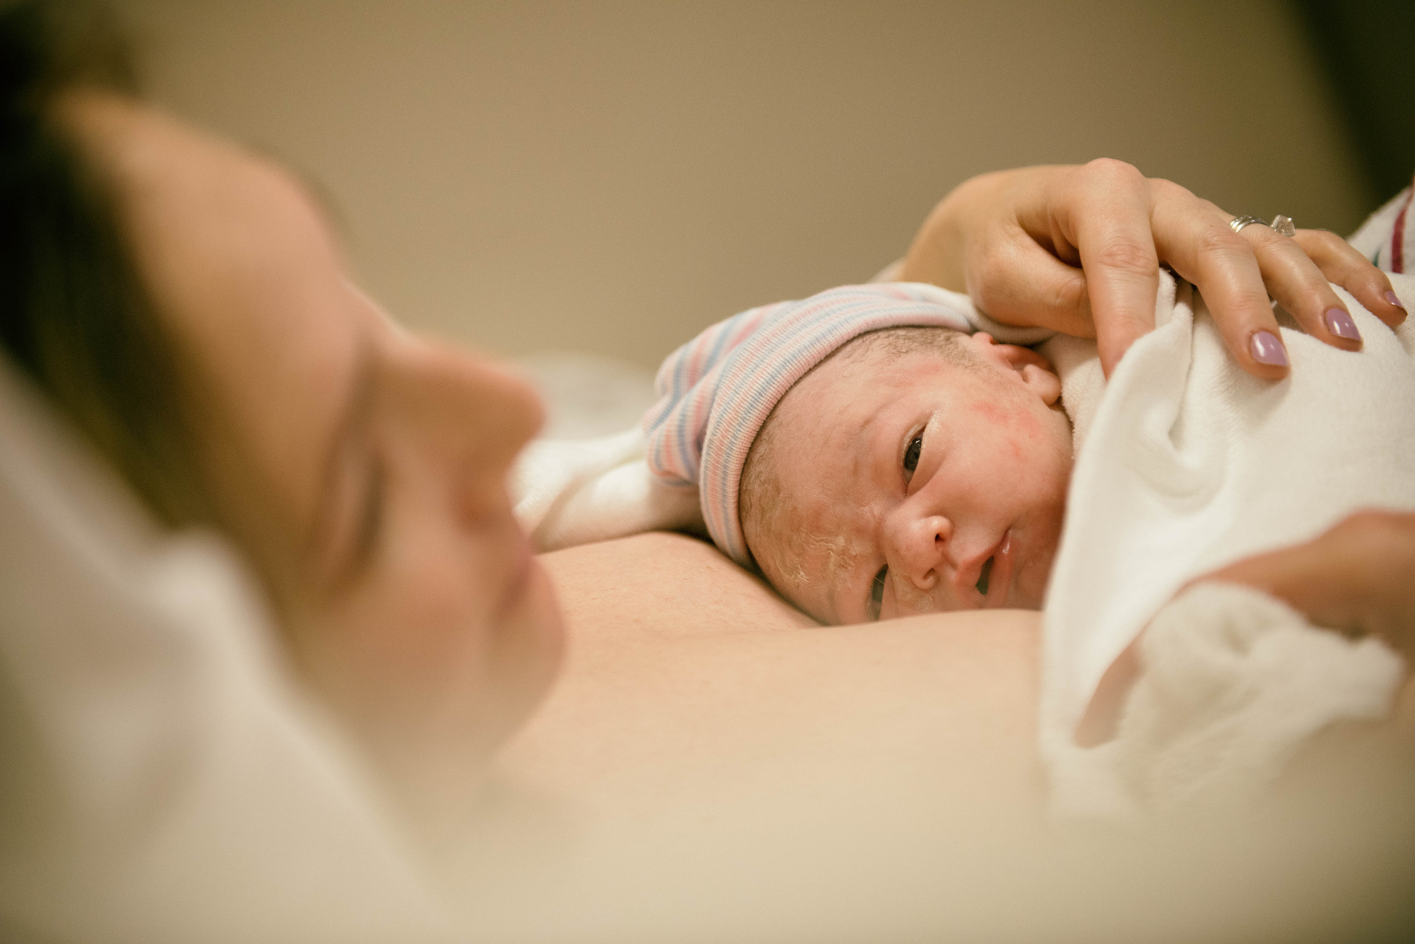


The safety of the midwives seems to be overlooked.
The country is in lockdown and yet midwives are expected to continue and provide care when we have no control over that environment
[ women’s homes ] .
All the reports/updated guidance refers to the safety of the women and their babies which is of course important, however the midwives and support workers safety is paramount. They are working through extremely challenging times.

Slide 16

Requests for home birth are increasing and
(we are) unable to provide cover for this given current staffing. Promotion of home births is being advocated by doulas and charities advising safest method of birth at this time.

Slide 17
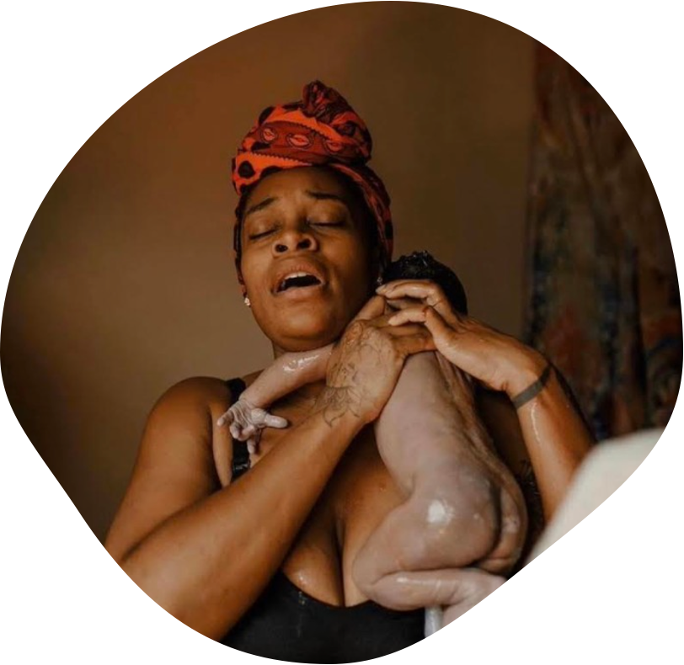
Conclusion
  The pandemic led to the centralisation of UK maternity care and the disruption of midwifery-led service provision, especially during the first wave of the pandemic in April-June 2020.
  There was significant regional variation in this disruption, and some suggestion that in NHS organisations with a stronger pre-existing commitment to community provision there was less centralisation.
  It was also apparent that in the second wave midwifery-led services were maintained to a greater extent.

Slide 18
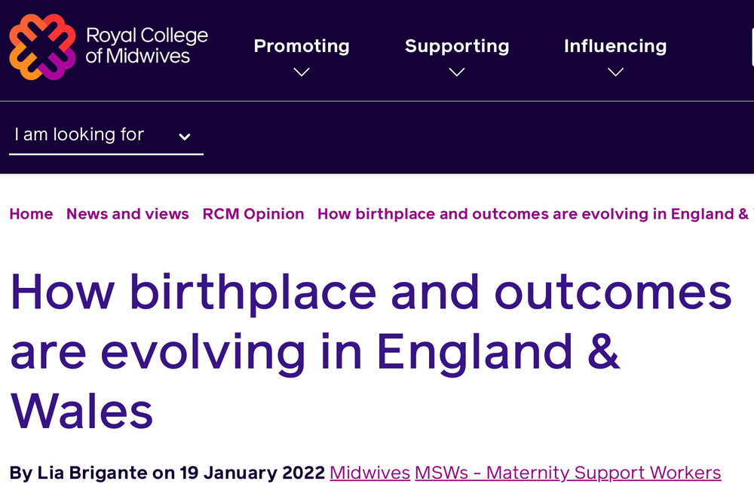

  Reversal of the declining homebirth rate.
  For the first time in five years, there is a slight increase to 2.4 per cent of births taking place at home in 2020 compared to 2.1 per cent in 2019.
  Variation in homebirth rate between geographical area , with areas with well-established midwifery continuity teams and community services, such as Powys in Wales having the highest homebirth rate (8.9%).

Slide 19

Acknowledgements:
Rachel Rowe
Mervi Jokinen
Alessandra Morelli
Rachel Plachcinski
RCM HoM/DoM Network
RCM Expert Clinical Advisory Group
UKMidSS reporters
UKMidSS steering group

Slide 20

Contact:
@lia_bri
lia.brigante@rcm.org.uk

