Slide 1
Hydration
understanding your rights and responsibilities in the workplace.

Slide 2
Hydration too much information?
It is important for our health, minds and wellbeing to be hydrated
What do you think when you hear this?

Slide 3
Feedback
I catch up on computer in my break
I don’t have time to go to the loo !
No staff to take over
I know all this but who’s going to look after my women & babies
I feel guilty it’s too busy
Not allowed a drink in clinical areas anyway!
It’s always been the same – nothing changes

Slide 4
RCM 2020 survey
48.2% skip meals including 27.8% always or most of the time.
52% feel dehydrated most or all the time at work because they don’t have enough time to drink.
87% delay using the toilet because they don’t have enough time, including
RCM member survey year | Feel dehydrated most or all of time | Delay using the toilet due to lack of time | Skip meals at work most or all of time
2016 | 62% | 62% | 44%
2017 | 56.6% | 54.2% | 37.7%
2020 | 51.96% | 87% | 27.8%

Slide 5
Let’s change the situation
Work with RCM workplace reps #caring for You
Information for members, branches Health and Safety reps available on RCM website
Break down the barriers, set the culture and be a role model

Slide 6
What to do
NMC Code 20.9 states:“ you must maintain the level of health you need to carry out your professional role.”
Report poor cultures, work with your colleagues and RCM representatives, record missed breaks, inform your managers. Ensure you are well healthy and safe to practise.
A healthy environment and hydration is key to your health wellbeing.
Keep fit be fit to care.

Slide 7
Health & Safety legislation
There's a clear duty on employers to provide drinking water at work, under the Workplace (Health, Safety and Welfare) Regulations 1992:
Regulation 22 Drinking water
An adequate supply of wholesome drinking water shall be provided for all persons at work in the workplace.
(2) Every supply of drinking water required by paragraph (1) shall – (a) be readily accessible at suitable places; and (b) be conspicuously marked by an appropriate sign where necessary for reasons of health and safety.
(3) Where a supply of drinking water is required by paragraph (1), there shall also be provided a sufficient number of suitable cups or other drinking vessels unless the supply of drinking water is in a jet from which persons can drink easily.

Slide 8
Health & Safety legislation
Workplace (Health, Safety and Welfare) Regulations 1992: Regulation 25 Facilities for rest and to eat meals
(1) Suitable and sufficient rest facilities shall be provided at readily accessible places.
(2); (b) include suitable facilities to eat meals where food eaten in the workplace would otherwise be likely to become contaminated.
(i) an adequate number of tables and adequate seating with backs for the number of persons at work likely to use them at any one time;
(ii) seating which is adequate for the number of disabled persons at work and suitable for them.
(4) Suitable facilities shall be provided for any person at work who is a pregnant woman or nursing mother to rest.
(5) Suitable and sufficient facilities shall be provided for persons at work to eat meals where meals are regularly eaten in the workplace.

Slide 9
Health & Safety legislation
Employers must ensure staff have the time to take the breaks to which they are entitled.
Under the Working Time Regulations 1998, UK workers are entitled to a minimum 20-minute break when working for six hours or more.
This break should:
Be uninterrupted
Be away from your workstation/working area
Take place during working time (so not right at the start or end of the working day)
Employers must take into account staff with underlying health conditions may require more breaks e.g., pregnancy/lactating, menopause, diabetes, or respiratory disease.

Slide 10
Self care
Listen to your body.
If you feel thirsty have a drink your body is telling you that you need fluid.
The colour of your urine is a good way to check how hydrated you are.
Our urine should be pale straw colour or clear.
If our urine is dark yellow or orange, we need to drink more.
If our urine is dark orange or brown, we are severely dehydrated and drinking plenty of fluid is essential to restore our dehydration.

Slide 11
Recommended daily fluid allowance for adults
Adults:
Men 2000mls per day
Women 1600mls per day
Pregnant women – as adults + 300mls per day
Lactating women – as adults + 600-700mls a day
Source: British Dietetic Association
Notes:
Everyone will need different amounts of fluid.
Checking your urine (wee) is so important, as this is a way of monitoring your hydration so you can personalise your fluid needs as you need to.
Lots of things affect how much fluid we need, including the weather and temperature, how much exercise you do and how much you naturally sweat. The hotter the temperature, the more exercise you do and the more you sweat, the more you need to drink.
Typically, the average adult needs between 1.5 to two litres of fluid a day. This is the equivalent to around 6-8 mugs of fluid.

Slide 12
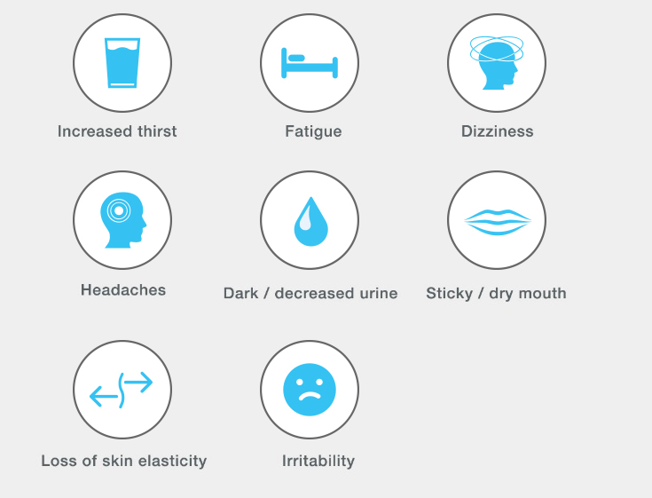
Dehydration signs
feeling thirsty - early sign becoming dehydrated
dark yellow and strong-smelling pee
feeling dizzy or lightheaded
feeling tired
dry mouth, lips and eyes
passing urine less, fewer than 4 times a day
Source https://www.nhs.uk/conditions/dehydration

Slide 13
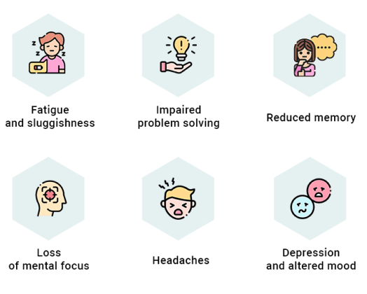
Effects of dehydration
Impaired cognitive behaviours
Fatigue – Increases risk of accidents driving at work or home
Increases potential for errors in clinical situations
Low morale
Fatigue mood swings

Slide 14
Remember how good is H2O ?

Slide 15
Hydration
H2O before you go.
H2O on the go.
H2O to make you go.

