Slide 1
Caring for You Action planning for activists.
Refresh 2022

Slide 2
Action plan SMART
Specific – well-defined and clear
Measurable – include measurable indicators to track progress
Attainable – realistic and achievable within the budget time resources, & experience available.
Relevant – align with your other goals
Timely – has a finishing date
Notes:
Producing an action plan is beneficial not only for individual basis but also for the organisation/employer., enables project managers or any member of a group to monitor their progress and take each task step-by-step, and efficiently. The advantage of doing this is, it allows you to develop a structured plan for the end goal you intend to achieve. Furthermore, it provides the team with appropriate foundations, prioritising the amount of time you spend on each task and prevent any side-tracking that may occur. Also creating a bond within a team, as each member is aware of their individual role, as well as providing necessary information to ensure success of the project – Using a SMART plan helps to remain focused and efficient.

Slide 3
Action plan top tips
Partnership working as a team decide group members and allocate individual roles/tasks.
Objectives: know what you want to do, try to specifically define what you want to achieve as early as possible.
Realistic in every aspect of the plan, state specific and achievable schedules, milestones and final outcomes.
Milestones set as measurable; create by starting at the end (what you hope to achieve) and working backwards to the present day.
Having milestones helps you keep everyone motivated and breaks actions/tasks into smaller chunks and tangible goals.

Slide 4
Action plan top tips
Time: don’t leave too much time between milestones, spacing them realistically will help you focus on what need to be done.
Publications:
Work related stress,
Working with the menopause,
Standing up for High Standards,
Flexible working guidance,
Involve members: share ideas and discuss at branch meetings feedback to the group.
Members will feel valued and heard by being consulted throughout planning and implementation and evaluation.
You said - we did.

Slide 5
Action plan monitor, evaluate and update
Allocate some time to monitor and evaluate the progress you’ve made with your team.
You can mark tasks that are completed as done on this final action plan, bringing attention to how you’ve progressed toward the goal.
This will also bring out the tasks that are pending or delayed, in which case you need to figure out why and find suitable solutions.
Then update the action plan accordingly.
The plan can be very fluid and interchangeable – evolving depending upon issues.

Slide 6
RCM action plan template
 | Objective | Outcomes | Actions | Progress | Lead | Target Date | Finished
1
2
3
Notes:
The point of this step is to create something that everyone can understand at a glance and that can be shared with everyone.
Whether your action plan comes in the shape of a flowchart, Gantt chart, or table, make sure that it clearly communicates the elements we have identified so far – tasks, task owners, deadlines, resources, etc.
This document should be easily accessible to everyone and should be editable.

Slide 7
RCM action plan example

Slide 8
Caring for You - employer evidence
Charter Theme | Policies required with regular reviews | Practices and behaviours | Public Statements and Commitments
Culture We commit to promote a positive, inclusive culture where staff feel valued, respected and invested in, ensure a safe and effective learning environment for students
Action We commit to work to in partnership with RCM branch and workforce business partners, to implement bespoke action plans based on local issues, identified by the maternity team.
Responsibility We will implement robust H&S strategies to prevent damage to staff wellbeing, ensuring zero tolerance of violence and/or aggression. As an employer we are committed to providing a safe and healthy working environment.
Evaluate at start on signing charter
Regular updates from action plan
Re Evaluate after 12 months /year on year
Caring for You - Employer Award
Notes:
Templates with examples and blank for local completion available on the Caring for You hub – Branches and activists resources.

Slide 9
Part 2 – example of implementing Caring for you in FT. – 2016 -2021.

Slide 10
Example – partnership working

Slide 11
St Mary’s Manchester University NHS FT Action plan 2016 - 2018
First UK Maternity Unit to sign up for the RCM Caring for you campaign in 2016.
Staff survey action plan agreed.
Speak out safely campaign shared.
Staff engagement forums established.
Staff side engagement and HR commitment
Staff Health and Wellbeing action plan drawn up.
Recruitment of staff to be increased
Staff support & retention.
Focused Educational support for revalidation & appraisals.
Divisional HR and E&D leads providing support.
To establish RCM Caring for You and St Mary’s What Matters to Me Campaign through partnership working.

Slide 12
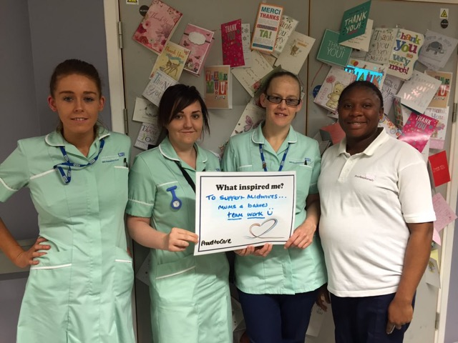
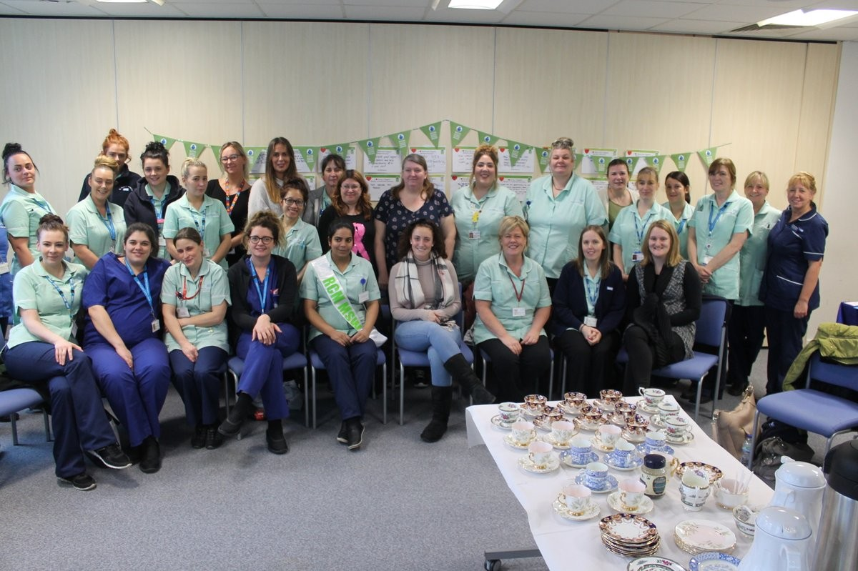
Going from good to great
Each area introducing more opportunities to ask What Matters To Me.
Recognise the challenges in different areas to make it meaningful & not tokenistic.
Supporting our Champions / leaders
Celebrating achievements
Listening and responding to areas of concerns – more local resolution and you said / we did.
Inclusion in transformation & service Improvement activities
!

Slide 13
MFT 2021- during pandemic
PMA’s have continued to support RCS sessions which have had really positive feedback.
HOM door is always open and visible in the unit everyday talking to the staff and keeping them updated.
HOM safety walk round every month and ask staff re any concerns and address every concern which is fed back to them.
Keep in touch with all staff who are offered a job pre commencing at the Trust
Excellent preceptorship program with bespoke support from our Education Team.
Wythenshawe have led the way in offering full preceptorship in community which we hope to follow on all sites as this is something some staff wanted.
Staff kept up to date re staffing and recruitment progress - via posters , core huddles and team meetings via the ward managers.
Celebrate excellence through excellent reporting and each area support staff member of the month.
DOM & HOM’s meet with the teams and RCM regional officer - very positive.
Recruitment and returners very positive – MFT a very popular choice.
HOM meets with the RCM reps each month which going incredibly well as the team were very visible with roving rep days each month.
Awaiting staff survey results yet but overall the culture in the units feels positive.

