Slide 1
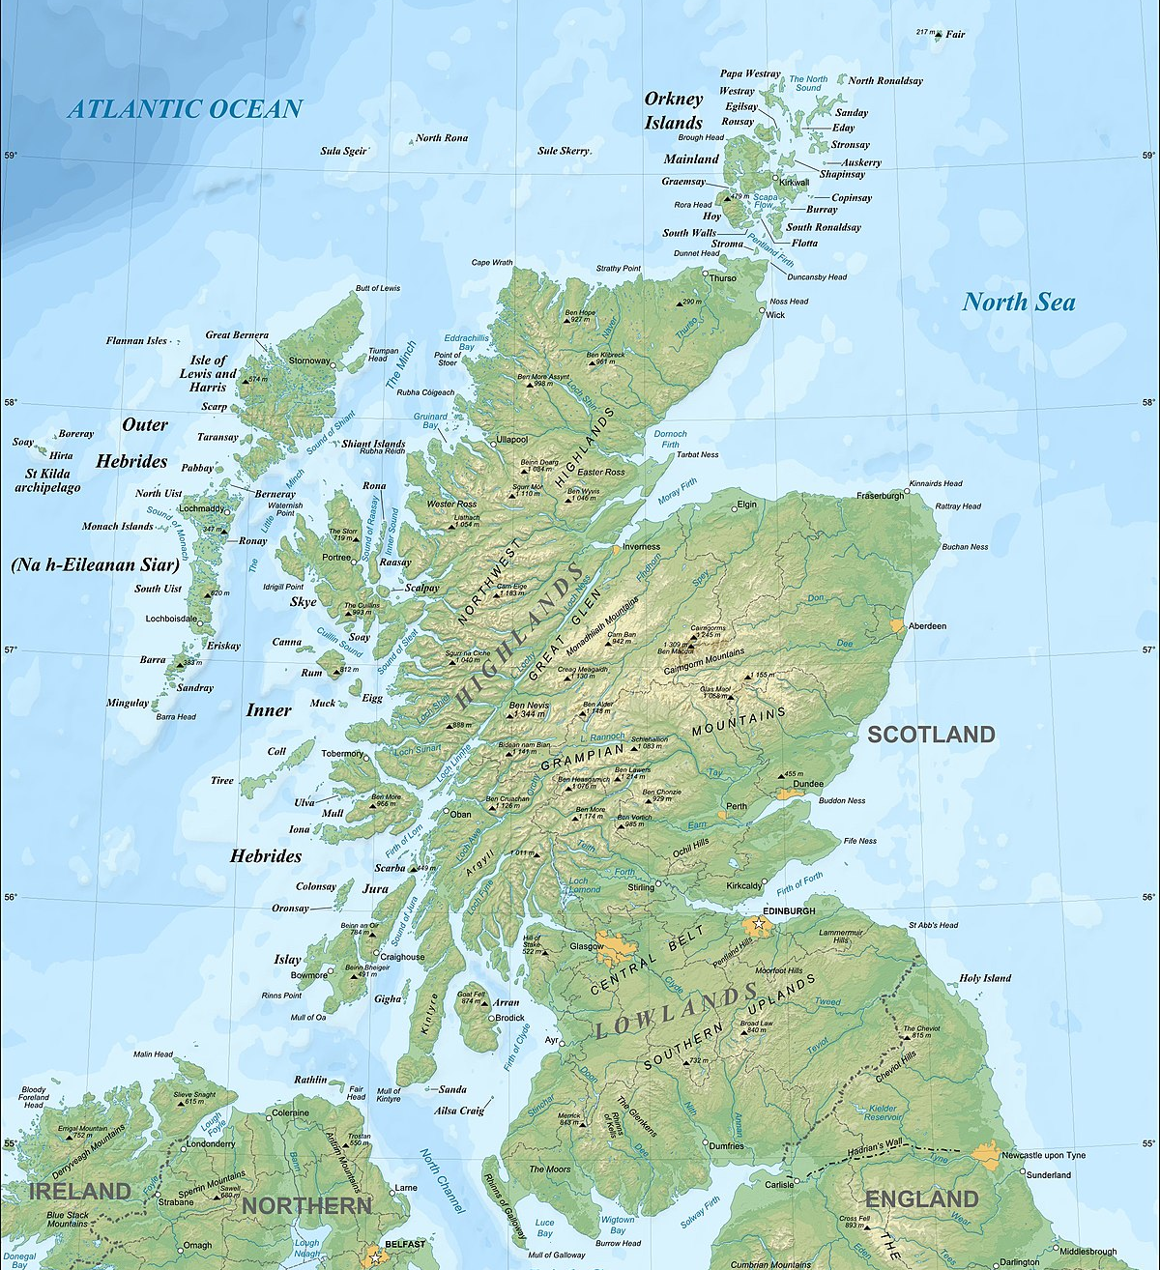


Empowering Midwives:
Advancing Maternity Care by bridging gaps in the time- critical administration of Tranexamic Acid (TXA) during situations of postpartum hemorrhage (PPH).
RCM Student Midwife Award 2023
Marie Buckleygray – Robert Gordon University

Slide 2

This talk is inspired by work carried out in Part 3, all case studies are fictional.
A show of hands please
Notes:
cast mind pph attended
importance access to your resources and kit

Slide 3
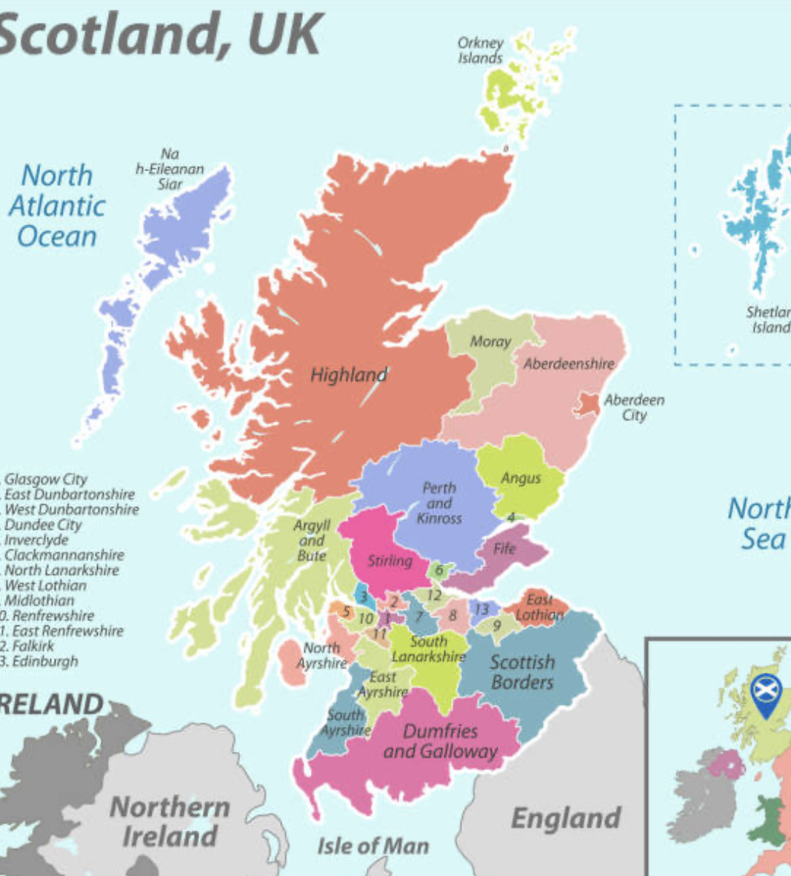

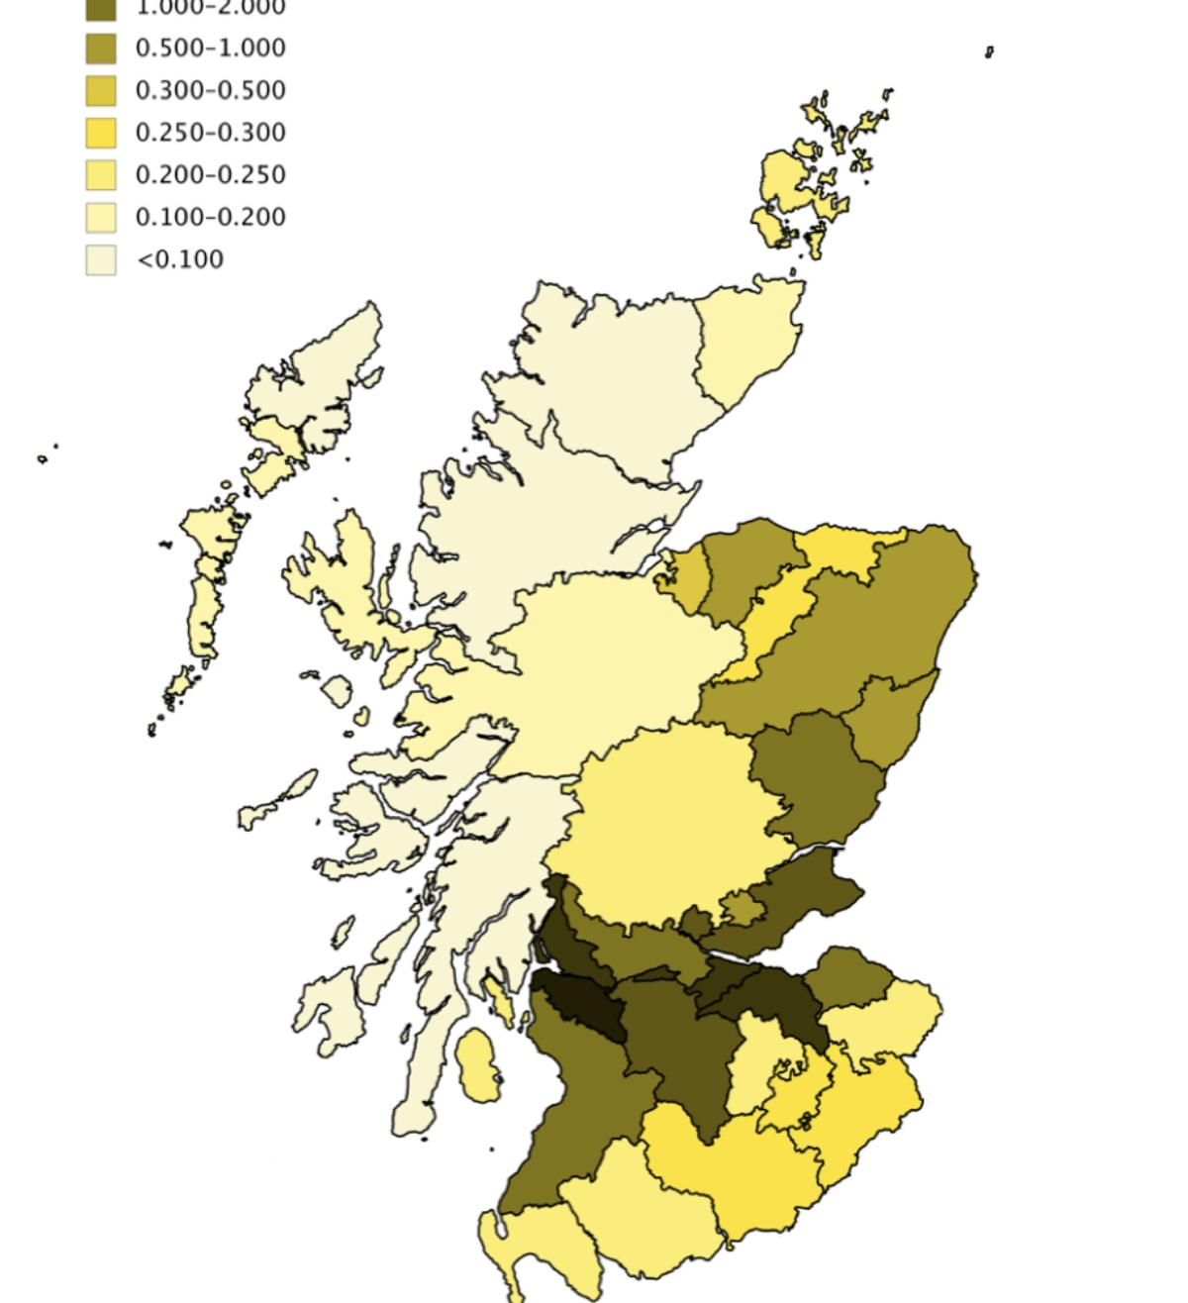
Demographics & topography
46,959 births in 2022
Notes:
We had almost 47k last yr
Importance of equitable service
maximises safety & effeciency
pop density
change of remote & rural topography

Slide 4
Recommendations:
What can we do?
Assessment: case studies
Background
Notes:
3 main area 5 mins

Slide 5

Midwifery workforce
Background
In March 2023 there were 3612 NMC registered midwives in Scotland. An increase of 83 from the year before.
The Midwives exemptions list permit the autonomous use of certain medications within scope of role.
Notes:
Midwifery workforce is mainly part time although numbers increased last year.
Some MW non-med prescribers most rely of Mid exemptions to deliver the right medication to the right person at the right time in the right place.
MWs will be the ones who are estimating pp blood loss

Slide 6

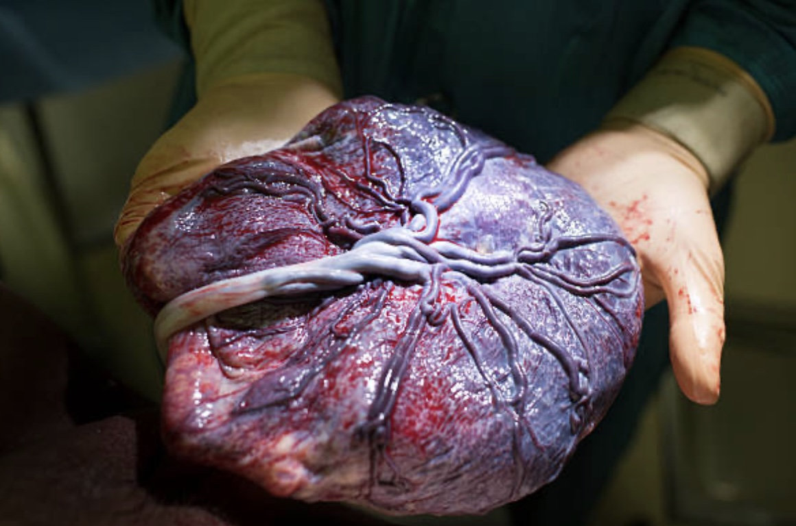
PPH
Background
TONE – 70%
TISSUE -9%
TRAUMA – 20%
THROMBIN - 1%
Notes:
depending on board 5-10,when you think about 47k Scottish births sig #

Slide 7

Severity of bleed & time sensitivity
Background
Notes:
pph more than 500ml,
sig can occur rate of 500 to 800ml per minute
addressing pph promptly is paramount
especially if you consider approx 20 women die due to perinatal bleeding each year in UK

Slide 8

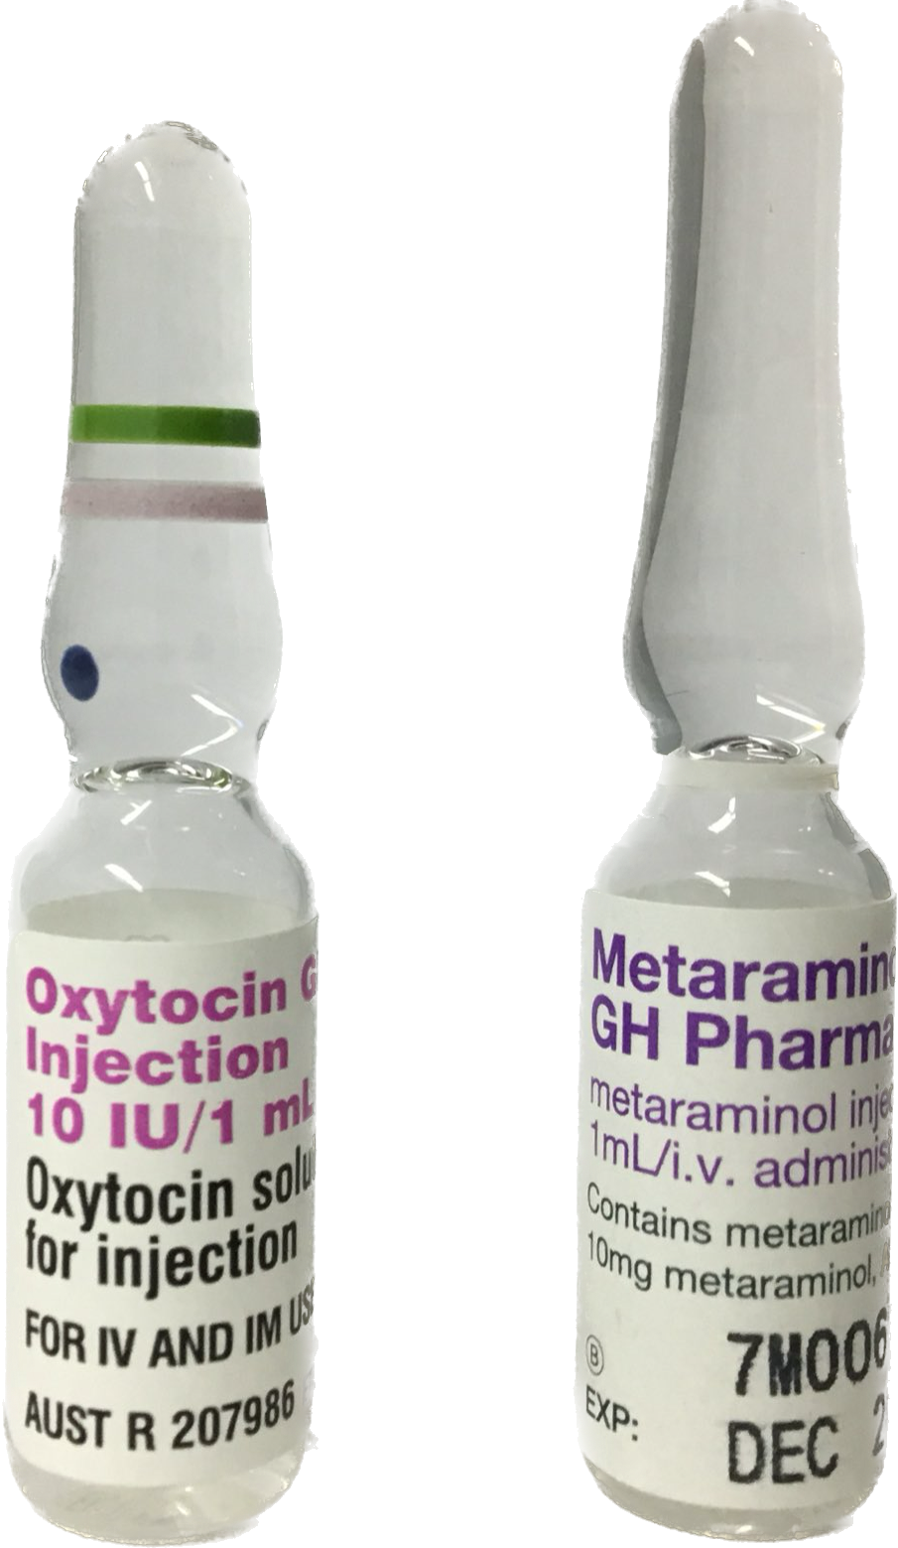


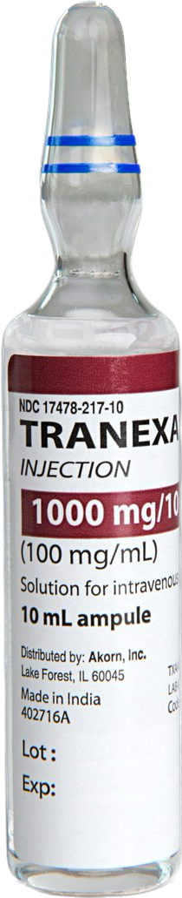
PPH Medication
Background
Notes:
reminder of the medications
three uterotonics on left
oxytocin, ergometriene & carbroprost- all on the mws exemptions list and in the standard birth kits
on the right we have txa which is an antifibrolytic which requires a prescription

Slide 9

TXA
Background
Inhibits enzymatic breakdown of fibrin
Shelf life, storage conditions & cost
Contraindications
Proven safety & efficacy
WHO, RCOG, NICE
Notes:
TXA inhibits bleeding without increasing risk of thromboembolism
It has a shelf life of 2 yrs, can be kept at room temp, and is shown to be financial prudent at approx 3pounds,
of course there are some contraindications as you wouldnt give it to a woman with severe renal issues
for the last 3 years TXA is recommended has standard pathway medication by the WHO. RCOG and NICE also recommend it.

Slide 10



Race against time with TXA
Background
70%
10%
0%
Notes:
There is a time sensitivity to administration of TXA
The WOMAN trial combined with the CRASH2 trial found that
70%, 10% 0%

Slide 11


Helen’s Birth at Hospital
Assessment with case studies
Notes:
Consultant led unit
her MW put out a 2222 MOH, short delay as gaining permission from prescriber

Slide 12



Siobhan’s Birth at a Stand-alone Midwife Led Unit
Assessment with case studies
Notes:
Stand alone MLU - her MW also put out a 2222MOH although paramedics arrived sooner and so they all travelled to the consultant led unit whilst receiving first TXA dose in ambulance

Slide 13
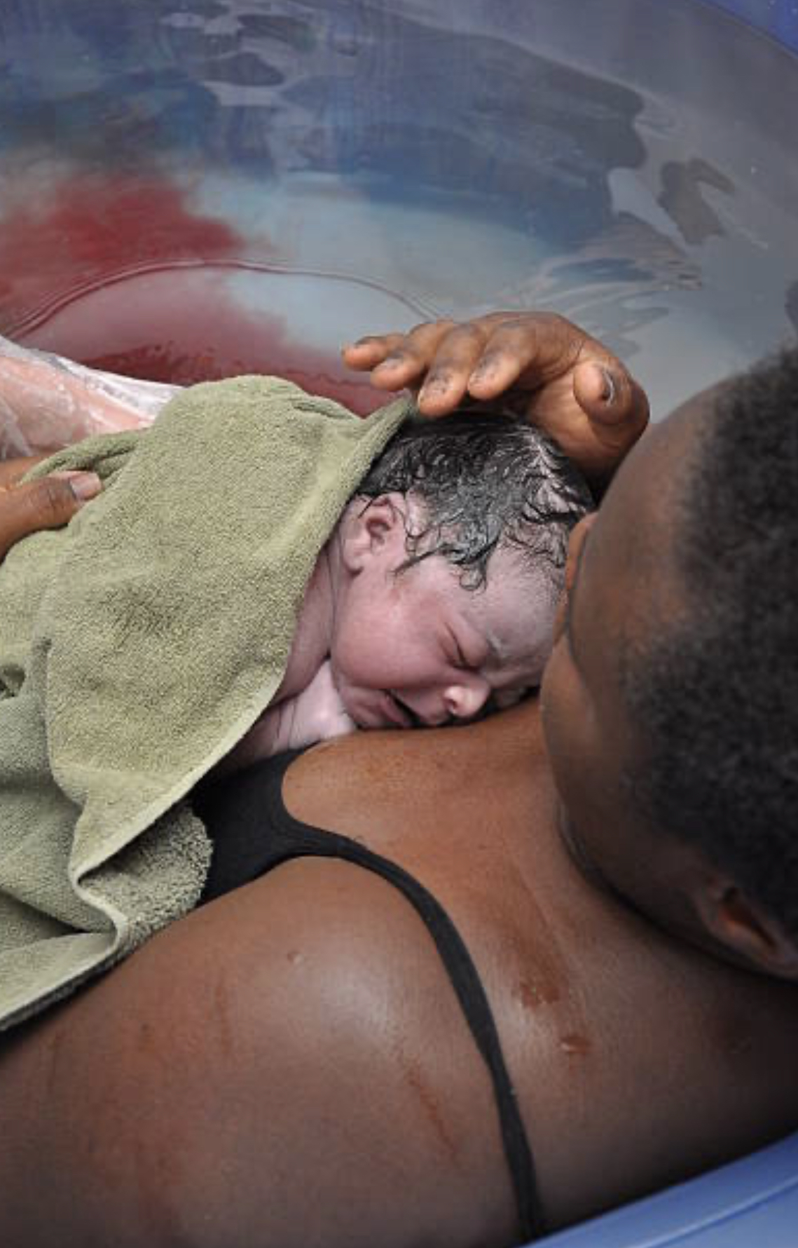


Belinda’s Birth at Home
Assessment with case studies
Notes:
Remote and rural birth at home
MWs tried to suture the source as the paramedics found getting to the home in winter took longer
It took a lot longer to administer first dose of TXA

Slide 14







Three case studies in a row
Assessment with case studies
Notes:
Helen 1 hr
Siobhan 2 hrs
Belinda 3 hours
care is not as equitable or effective as it could be
also their poor midwife is feeling worn down and frustrated behind closed doors

Slide 15


It’s time to gather
Introduce Patient Group Directives for midwives using TXA in every Board in Scotland
Include TXA on the NMC Midwives’ Exemption List
Recommendations
Notes:
Truly time to gather to resolve this issue
TXA invented more than 60 yrs ago by two Japanese Drs specificly to assisted at pph- let's have courage to
come together and use our influence to get txa on the MW Exemptions list by first getting each board in Scotland with a PGD set up.

Slide 16
Impact of change for families
Decrease in severity of PPH
Fewer blood transfusions
Improved breastfeeding experience
Home sooner
Improved postnatal mental and physical health
Potentially reducing maternal mortality rate
More time to bond
Recommendations
Notes:
Let's not lose sight of the benefits for families

Slide 17

Impact of change for NHS & Midwifery
Reduced cost in additional care and legal fees
Improved balance of work with MDT
Improved mental and physical health of staff
Potentially reducing staff attrition
Recommendations
Notes:
& also the benefits for the NHS and our profession

Slide 18

Remove the barriers for midwives to autonomously use TXA within their scope of practice
Recommendations
Notes:
When we work together we can really make a difference. This is an important public health issue and it deserves our attention.

Slide 19


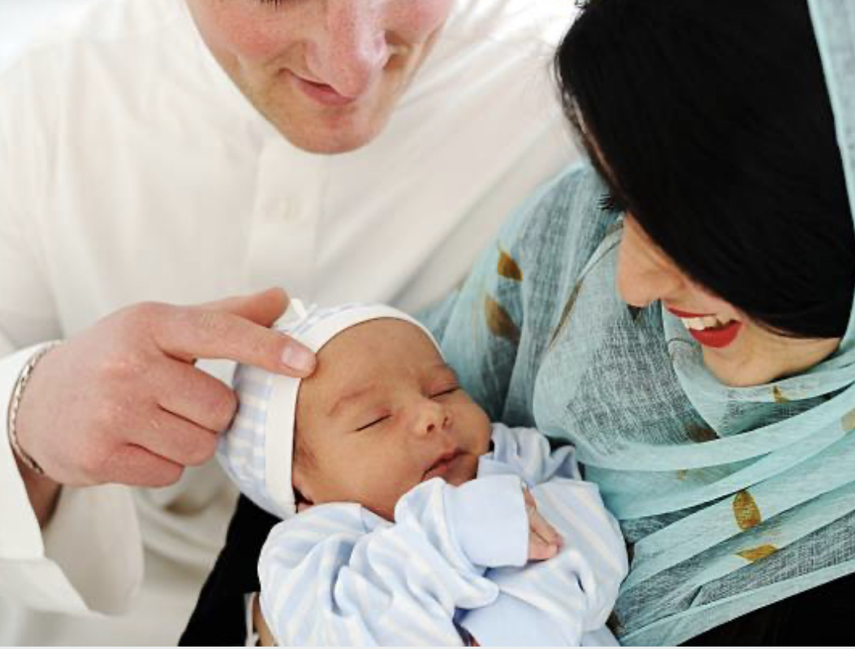




Thank you
Notes:
On behalf of Scotland's families thank you for your work and for taking this presentation into consideration.

Slide 20
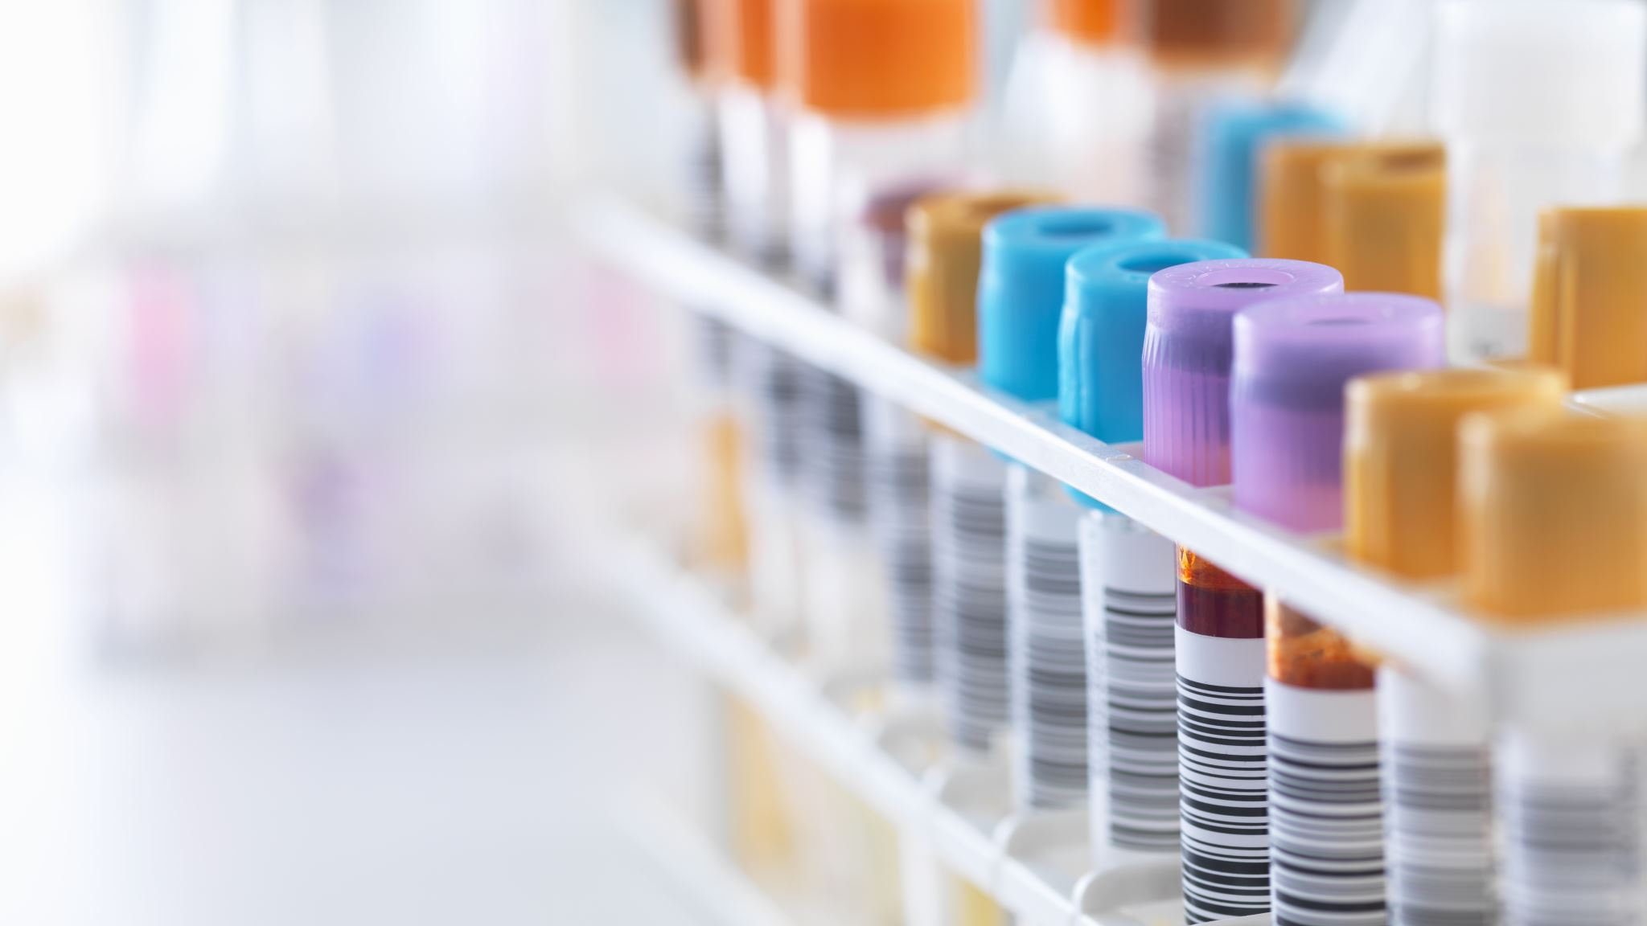
References
Brenner, A., Ker, K., Shakur-Still, H. and Roberts, I., 2019. Tranexamic acid for post-partum haemorrhage: What, who and when. Best Practice & Research Clinical Obstetrics & Gynaecology, 61, pp.66-74.
Daru, J., Zamora, J., Fernández-Félix, B.M., Vogel, J., et al. 2018. Risk of maternal mortality in women with severe anaemia during pregnancy and post partum: a multilevel analysis. The Lancet Global Health, 6(5), pp.e548-e554.
Knight, M., 2022. MBRRACE‐UK update: Key messages from the UK and Ireland Confidential Enquiries into Maternal Death and Morbidity 2021. The Obstetrician & Gynaecologist, 24(1), pp.79-81.
Letson, H.L. and Dobson, G.P., 2017. Tranexamic acid for post-partum haemorrhage in the WOMAN trial. The Lancet, 390(10102), pp.1581-1582.
National Records of Scotland, 2022. National Records of Scotland. Available at [online]: https://www.nrscotland.gov.uk/news/2022/birth-rate-the-second-lowest-since-records-began (Accessed: 15 October 2023).
Nursing and Midwifery Council, 2023. The NMC register mid-year update. September 2022- March 2023.
Roberts, I., Shakur, H., Coats, T., et al. 2013. The CRASH-2 trial: a randomised controlled trial and economic evaluation of the effects of tranexamic acid on death, vascular occlusive events and transfusion requirement in bleeding trauma patients. Health Technol Assess, 17(10), pp.1-79.
Vogel, J.P., Oladapo, O.T., Dowswell, T. and Gülmezoglu, A.M., 2018. Updated WHO recommendation on intravenous tranexamic acid for the treatment of post-partum haemorrhage. The Lancet Global Health, 6(1), pp.e18-e19.

