Slide 1


Exploring women’s experiences of midwifery care in subsequent pregnancy following baby loss within the United Kingdom and Ireland
Extended literature review
Morag Gibbs – ENU

Slide 2

Under researched topic
Originally wanted to focus on miscarriage specifically
Search strategy carried out in a systematic manner returned one article
Opening out to baby loss generally didn’t increase literature pool dramatically
Five articles included within the review

Slide 3
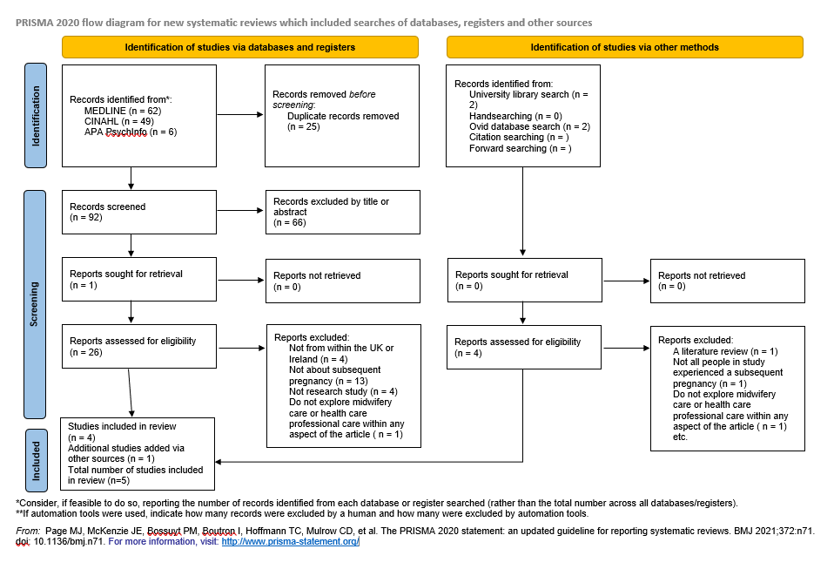
Literature review search results
PRISMA diagram:
Articles included:
Flannery, C., Hennessy, M., Dennehy, R., Matvienko-Sikar, K., Lucey, C., Dhubhgain, J., & O’Donoghue, K. (2023). Factors that shape recurrent miscarriage care experiences: findings from a national survey. BMC Health Services Research, 23(1), 317–
Mills, T., Ricklesford, C., Heazell, A., Cooke, A., & Lavender, T. (2016). Marvellous to mediocre: findings of national survey of UK practice and provision of care in pregnancies after stillbirth or neonatal death. BMC Pregnancy and Childbirth, 16(1), 101–101. https://doi.org/10.1186/s12884-016-0891-2
Mills, T., Roberts, S., Camacho, E., Heazell, A., Massey, R., Melvin, C., Newport, R., Smith, D., Storey, C., Taylor, W., & Lavender, T. (2022). Better maternity care pathways in pregnancies after stillbirth or neonatal death: a feasibility study. BMC Pregnancy and Childbirth, 22(1), 1–634. https://doi.org/10.1186/s12884-022-04925-3
Smith, D., Thomas, S., Stephens, L., Mills, T. A., Hughes, C., Beaumont, J., & Heazell, A. E. P. (2022). Women’s experiences of a pregnancy whilst attending a specialist antenatal service for pregnancies after stillbirth or neonatal death: a qualitative interview study. Journal of Psychosomatic Obstetrics and Gynaecology, 43(4), 557–562. https://doi.org/10.1080/0167482X.2022.2098712
Wheeler, Fragkiadaki, E., Clarke, V., & DiCaccavo, A. (2022). “Sunshine”, “angels” and “rainbows”: language developed by mothers bereaved by perinatal loss. British Journal of Midwifery, 30(7), 368–374. https://doi.org/10.12968/bjom.2022.30.7.368

Slide 4

Critical analysis and discussion of findings
Breaking the silence
Bereaved parents often feel isolated as people struggle to talk to them about their loss – compounding heightened emotions including anxiety and fear
Healthcare professionals can add to this or reduce it – important to be aware of someone’s story
Midwives have a role to play in this – can provide a safe space for people to share
Can adopt bereaved parent’s language

Slide 5

Critical analysis and discussion of findings
Continuity of carer
Evidence points to improved outcomes for low-risk women
Could also be beneficial for those experiencing pregnancy after baby loss
Some of the women in studies expressed this aids relationship building, reduces having to share their story repeatedly, provides consistency
Allows opportunities for emotional and clinical support
Future research could focus on this demographic

Slide 6

Critical analysis and discussion of findings
Psychological AND physical support
All studies highlighted women are often more anxious and fearful in subsequent pregnancy
Healthcare professionals, including midwives, feature significantly in increasing or reducing this
Negative points raised include unawareness of obstetric history, not feeling supported, not feeling listened to or communicated with effectively
Systems often do not help this – staffing/workload pressures, maternity unit guidance not specifically focused on subsequent pregnancy
New NBCP has a focus on emotional support in subsequent pregnancy, though ambiguity exists about how this is measured
Additional staff training could help midwives with providing this

Slide 7

Critical analysis and discussion of findings
Access to specialist services and care
Highlighted as beneficial to women within some of the studies
However, this can be variable and may lead to healthcare inequality
Ockenden recommendation – access to appropriate and adequate bereavement services.
This should extend to subsequent pregnancy
Need for specialist roles such as bereavement midwives as well as other specialists – an emphasis on staff training and development in area of subsequent pregnancy could be part of their job description
Standard antenatal classes highlighted within a study and other literature as inadequate for people’s lived experiences, this could be developed further

Slide 8

Recommendations for practice
Greater awareness for healthcare professionals
Create opportunities to talk about previous loss, even in midst of current pregnancy
Take time to know someone’s history
Time constraints and fear can hinder this
Shared language can help this
Holistic, individualised care is needed in this area

Slide 9

Recommendations for practice
Development of specific staff training
Good bereavement training already exists
Perhaps a focus on subsequent pregnancy could be incorporated into this
Or specific additional training around support in subsequent pregnancy
People may require additional support and midwives should be able to facilitate this

Slide 10

Recommendations for practice
Specialist, specific antenatal classes
Inadequacy of standard classes for people who have experienced baby loss evidenced within the literature
Appears little done to address this
Specific classes could share information and provide additional emotional and physical support – with understanding and acknowledgement of people’s lived realities
Could cover a small area of whole health board area, depending on need
Partnership with third sector organisations is vital – particularly baby loss support charities who have considerable expertise
Partnerships between baby loss support charities and health boards already exist, with ongoing projects in some, this could form another

Slide 11

Thank you!
All images used in presentation from Microsoft PowerPoint Stock Images

