Slide 1

Pregnancy After Loss
Exploring Women’s Experiences
Eilidh Pearce

Slide 2
The Aim
This project aimed to explore women’s experiences and perceptions of pregnancy after previous pregnancy loss.
Subthemes including ‘perinatal mental health’, ‘the facility for support’ and pregnancy loss as a ‘taboo subject’.

Slide 3
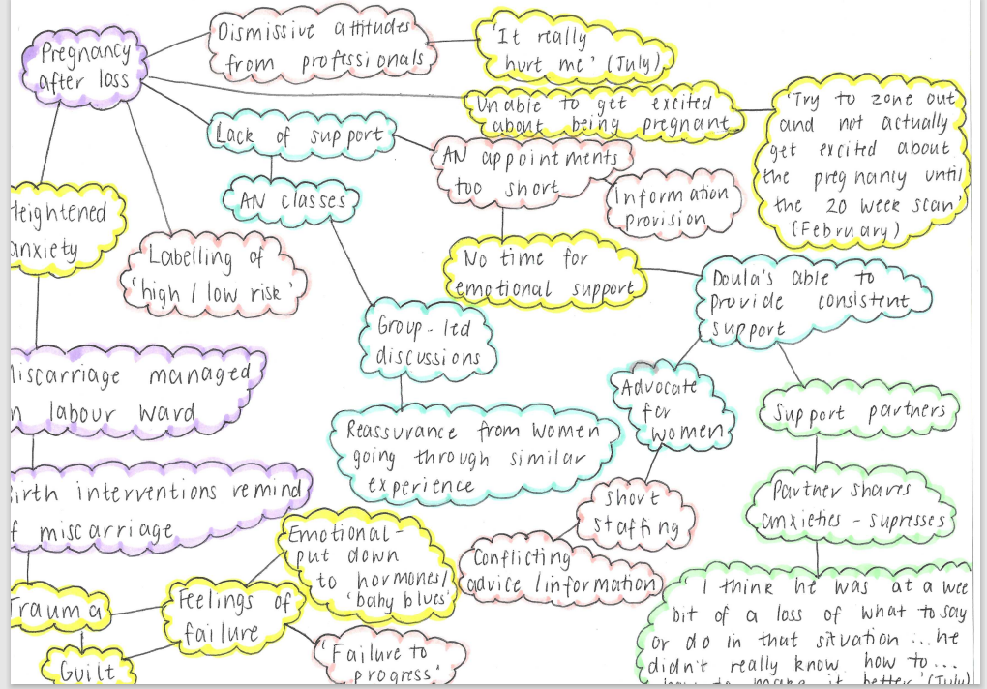
The Inspiration
Notes:
Podcasts were the medium which themes were devised from to provide focus for the project.
A thematic analysis approach was adopted to devise themes.
I initially collated points which resonated with me from the woman’s narratives. I then arranged these into a mind-map and colour-coded these. Purple referred to points relating to ‘pregnancy after loss’, pink ‘practice issues and constraints’, yellow ‘perinatal mental health, blue ‘support’ and green ‘support for partners’. I then combined these areas of interest to create the focus of my assignment as ‘pregnancy after loss’ with the subthemes of ‘ facility for support’ and ‘perinatal mental health’.

Slide 4
Narrative Literature Review
To explore the topic, I conducted a narrative literature review.
Sources explored included journal articles, grey literature, women’s narratives, podcasts, blogs and online magazines.
Notes:
The narrative literature review included a broad range of sources were used to gain understanding of women’s firsthand experiences.
I again adopted a thematic analysis approach to devise themes from the literature review, these were ‘perinatal mental health’, ‘a taboo subject’ and ‘support’.

Slide 5
Perinatal Mental Health
22.5% of women who had previously lost a baby experienced anxiety during subsequent pregnancies and 19.7% suffered from depression (Gravensteen et al., 2018).
Women reported to have a ‘heightened awareness of risk’ and were ‘on high alert’ (Smith et al., 2022; Moore & Côté-Arsenault, 2018).
Trauma from previous losses had a profound impact on subsequent pregnancies.
Women questioned their ability to be a mother.
Physical health was prioritised over mental health by professionals.
Notes:
This provides a summary of the points in relation to perinatal mental health around pregnancy after loss found from the literature review.
Thus, it can be deduced that this group of women are vulnerable to mental health issues and require additional support.

Slide 6
A Taboo Subject
Pregnancy loss is a topic often avoided in conversation, possibly due to the societal discomfort that surrounds death as a subject.
Women wait until 12 weeks to announce pregnancy- creating more secrecy and reducing support.
‘Social uncertainty’- women feel shameful and guilty.
Balance between wishing to educate others and to avoid uncomfortable discussions.
Societal change- more openness around the topic. #ThisIsCouraegouslyExpecting (Albers, 2022), ‘Baby Loss Awareness Week (Barber et al., 2018).
Notes:
It was clear throughout women’s accounts that secrecy around the subject remains.
This further isolates women and restricts the support available.
It does seem to be improving with movements such as this one on Instagram and ‘Baby Loss Awareness Week’ (Barber et al., 2018).

Slide 7
Support
Support crucial, but difficult to find.
Continuity of care significant in creating trust and positive midwife-women relationships.
Barriers meaning continuity inconsistent- women lose trust in healthcare whilst simultaneously relying on it.
Women find support from those who have had similar experiences.
Specialist clinics for women pregnant after loss found to have positive outcomes.
Notes:
There continues to be barriers to support for women pregnant after loss.
Continuity of care and carer was identified as significant yet not always available.

Slide 8
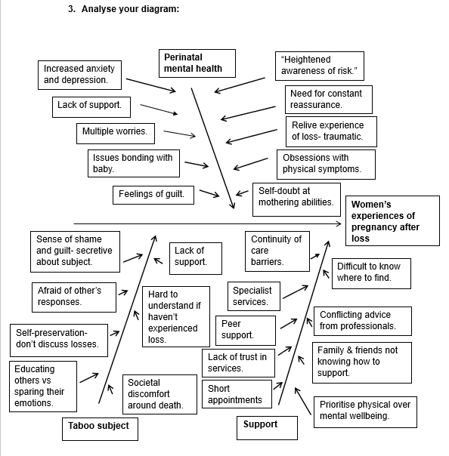
Change Management
Notes:
From the findings of the literature review, I created a fishbone diagram to identify potential areas of change in practice.
NHS England and NHS Improvement. (n.d.)

Slide 9
Suggested Care Improvements
Individualised care with women at the centre.
Continuity of carer enabled.
Additional training for midwives in providing pregnancy loss and pregnancy after loss care.
Specialised interventions for women pregnant after losing a baby.
Tailored antenatal classes offering parent education and emotional support.
Creation of care pathways for women pregnant after loss, such as those detailed by The Lancet (2021) in their article calling for a worldwide reform of miscarriage care.
Drive to continue to raise awareness to breakdown taboo.
Notes:
These are the main improvements which I believe could be made to practice.
As always, individualised care is of the utmost importance in ensuring women feel listened to and supported.
Continuity of carer should also be prioritised as it is clear the difference that it can make.
Additional training for midwives should result in women trusting their care providers more and in midwives not feeling out of their depth.
Care pathways such as those suggested by The Lancet (2021) in their article pushing for a worldwide reform of care surrounding miscarriage.

Slide 10
References
Albers, J. (2022). This Is Courageously Expecting: The Movement. This Is Courageously Expecting: The Movement - Jenny Albers
Gravensteen, I. K., Jacobsen, E.M., Sandset, P. M., Helgadottir, L. B., Radestad, I., Sandvik, L., & Ekeberg, O. (2018). Anxiety, depression and relationship satisfaction in the pregnancy following stillbirth and after the birth of a live-born baby: a prospective study. BMC Pregnancy and Childbirth, 18(1), 41. https://doi.org/10.1186/s12884-018-1666-8
Moore, S. E., & Côté-Arsenault, D. (2018). Navigating an Uncertain Journey of Pregnancy After Perinatal Loss. Illness, Crisis, and Loss, 26(1), 58–74. https://doi.org/10.1177/1054137317740802
NHS England and NHS Improvement. (n.d.). Online library of Quality, Service Improvement and Redesign tools: Cause and effect (fishbone). Layout 1 (england.nhs.uk). Accessed 7th June 2023
Smith, D. M., Thomas, S., Stephens, L., Mills, T. A., Hughes, C., Beaumont, J., & Heazell, A. E. P. (2022). Women’s experiences of a pregnancy whilst attending a specialist antenatal service for pregnancies after stillbirth or neonatal death: a qualitative interview study. Journal of Psychosomatic Obstetrics and Gynaecology, 43(4), 557–562. https://doi.org/10.1080/0167482X.2022.2098712
The Lancet. (2021). Miscarriage: worldwide reform of care is needed. The Lancet (British Edition), 397(10285), 1597–1597. https://doi.org/10.1016/S0140-6736(21)00954-5

